Slide 1

ECPGR
The European Cooperative Programme for Plant Genetic Resources
Name of presenter
Title
Event
Date
Notes:
h

Slide 2



ECPGR – The European Cooperative Programme for Plant Genetic Resources
ECPGR is a collaborative programme involving most European countries, aimed at ensuring the long-term conservation and enhanced utilization of plant genetic resources (PGR) in Europe.
www.ecpgr.org
www.linkedin.com/company/ecpgr

Slide 3
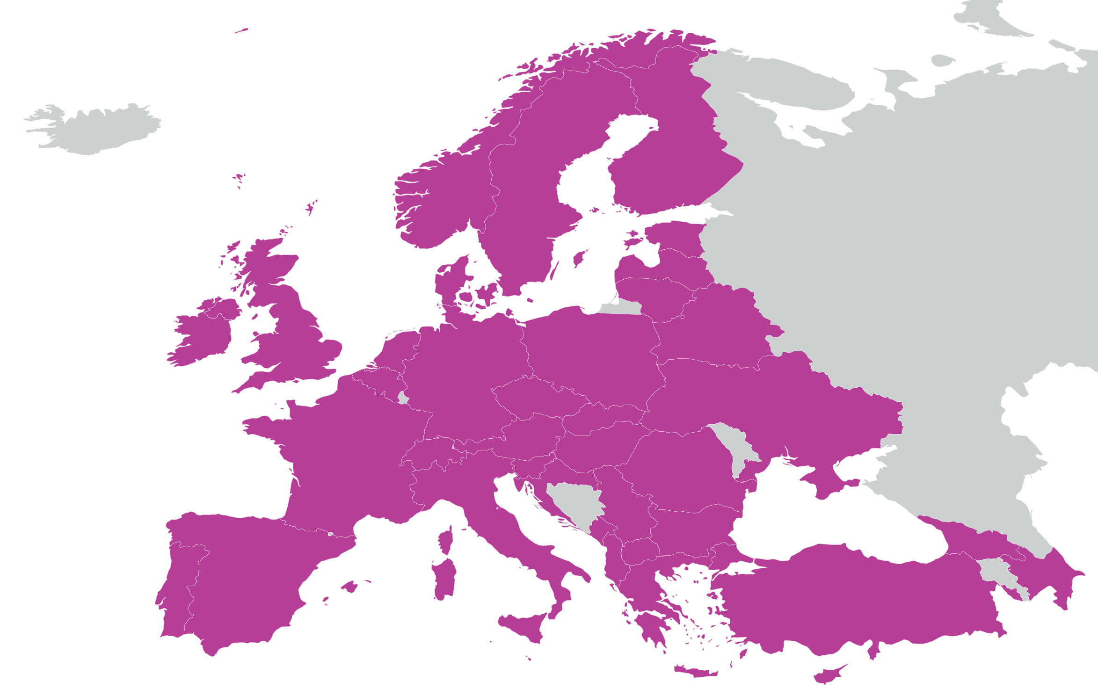
ECPGR Membership
Founded in 1980 under the auspices of EUCARPIA, FAO and UNDP as an area of cooperation to be established between East and West Europe.
Self-funded programme belonging to the participating countries. Member countries also contribute in kind to the programme, through collaborative PGR conservation and use activities.
37 countries have pledged support for 2024–2028
The boundaries shown on this map do not imply official endorsement or acceptance by ECPGR
Notes:
The map includes 37 countries that should participate in phase XI:
Albania, Austria, Azerbaijan, Belarus, Belgium, Bulgaria, Croatia, Cyprus, Czech Rep., Denmark, Estonia, Finland, France, Georgia, Germany, Greece, Hungary, Ireland, Italy, Latvia, Lithuania, Montenegro, Netherlands, North Macedonia , Norway, Poland, Portugal, Romania, Serbia , Slovakia, Slovenia, Spain, Sweden, Switzerland, Turkiye, Uk, Ukraine,

Slide 4

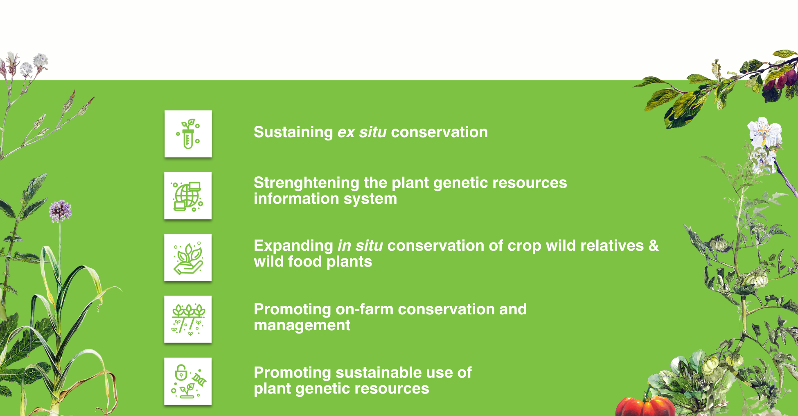
ECPGR Objectives

Slide 5
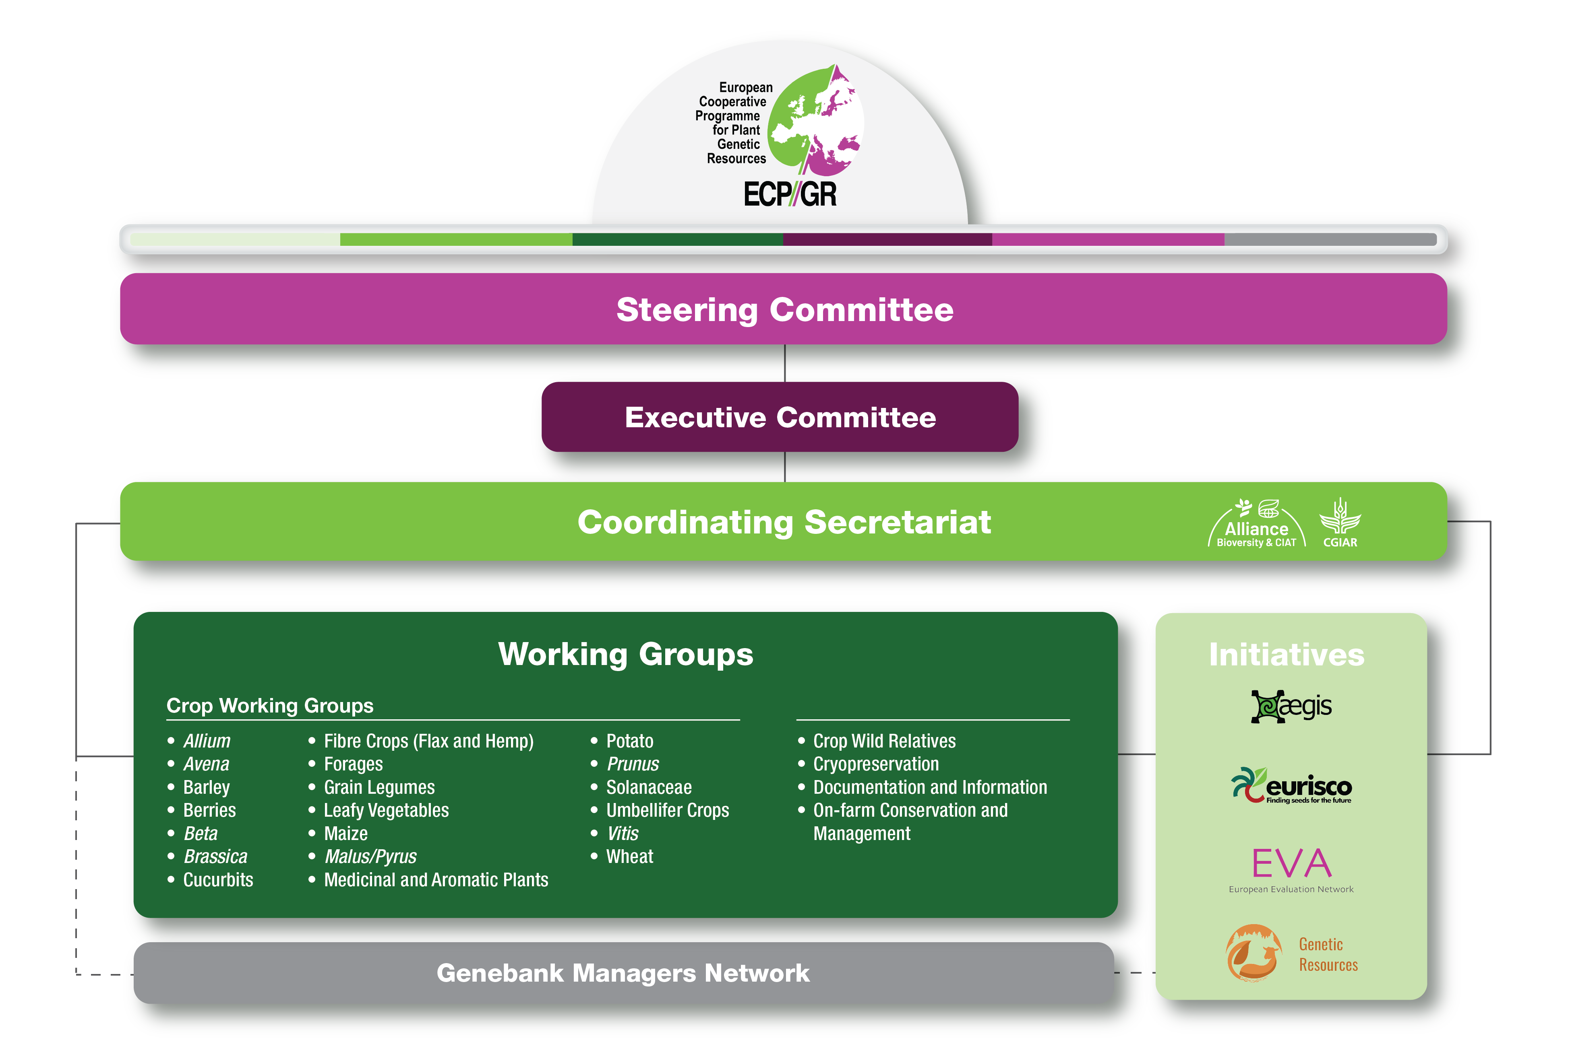
ECPGR Structure

Slide 6
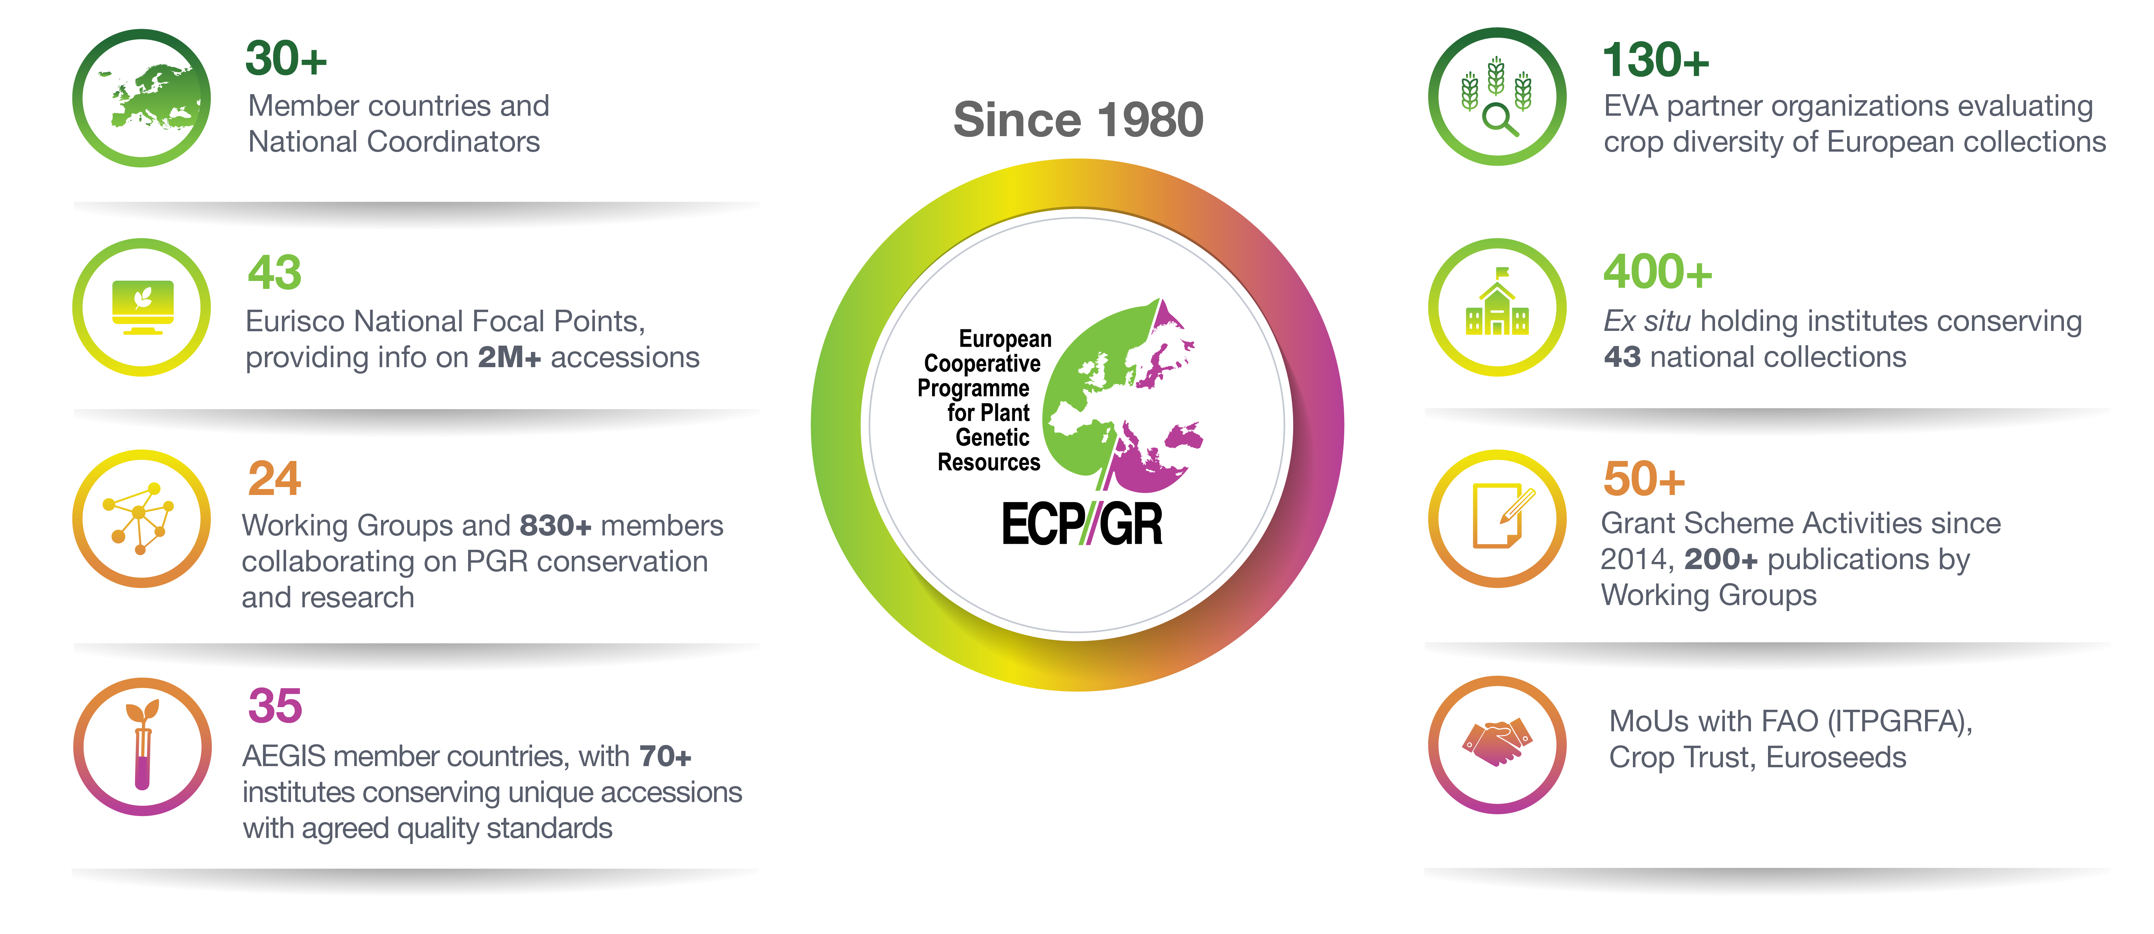
ECPGR has been a central and reliable coordinating hub for PGR conservation, use and research for 45 years
www.ecpgr.org

Slide 7
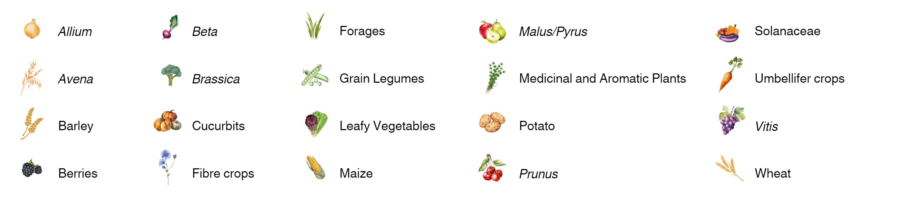
ECPGR Working Groups
Crop Working Groups
Thematic Working Groups

Slide 8
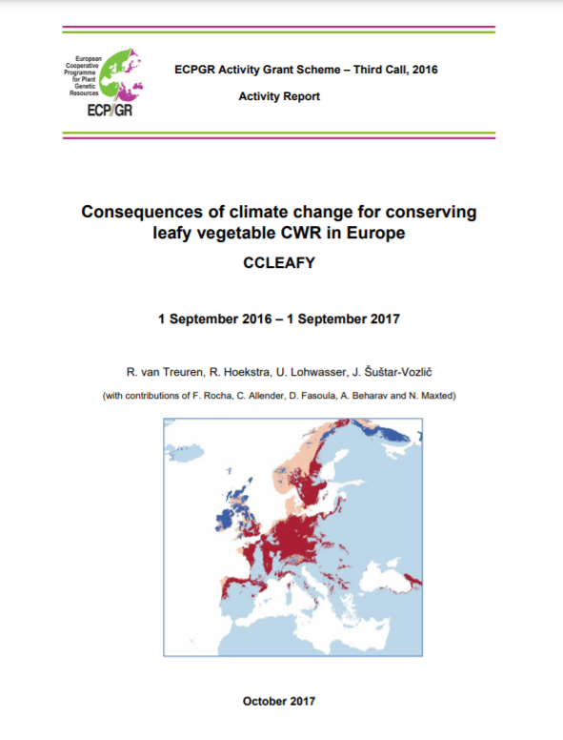
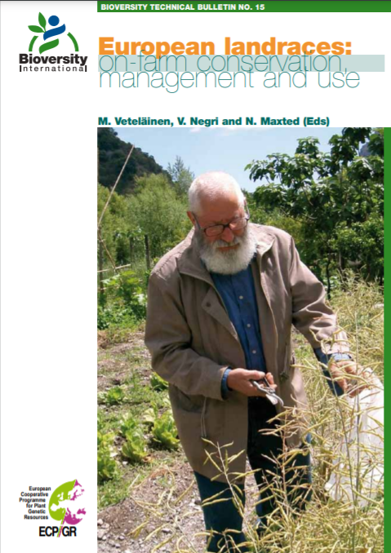

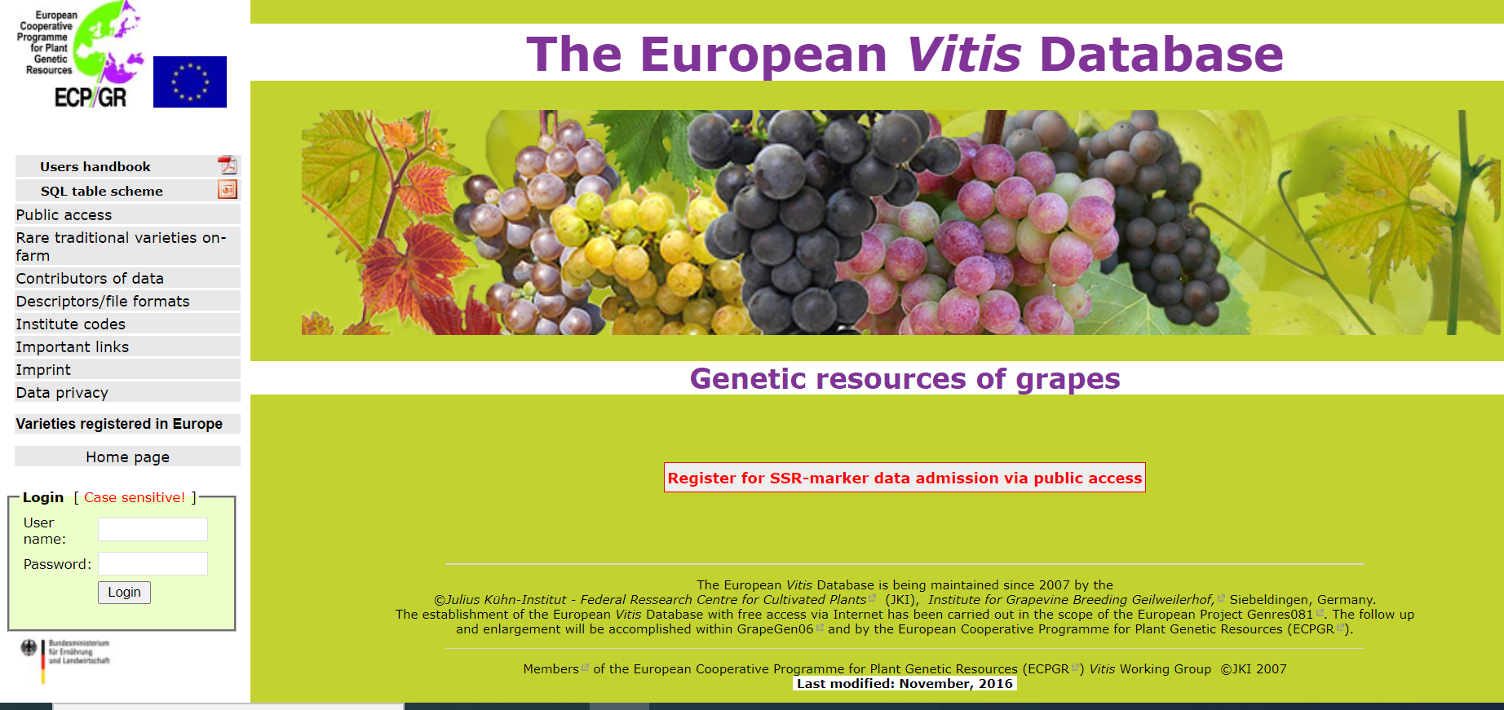
ECPGR Working Group initiatives
Collaborative projects
Reports and publications
Guidelines and standards
PGR descriptor lists
Crop databases

Slide 9
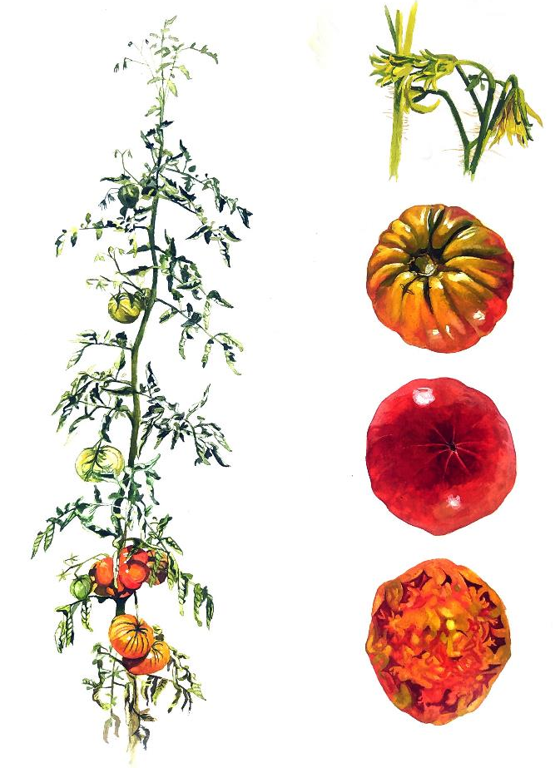
ECPGR Grant Scheme Activities
ECPGR member countries provide funding for actions led by Working Groups (WGs) to support the objectives of ECPGR and the Plant Genetic Resources Strategy for Europe
Annual calls for WG activity proposals are launched and evaluated by the ECPGR Executive Committee
Since 2014, over 50 activities have been funded through this mechanism.
© Fernando Luque / ECPGR

Slide 10




ECPGR Initiatives
Documentation
European Search Catalogue for Plant Genetic Resources
Ex situ Genebank Operations
and Quality Management
A European Genebank Integrated System
PGR Access and Use
European Evaluation Network for PGRFA
Dissemination
Open Access Journal
www.genresj.org

Slide 11


Documentation
Online catalogue
Information on European ex situ collections:
passport, characterization and evaluation data
Extension to in situ populations recently implemented
Largest single PGR data provider at accession level
Register for the multilateral system and feeding into Genesys global database
Hosted by:
EURISCO: A central hub to make European PGR data publicly available
http://eurisco.ecpgr.org

Slide 12

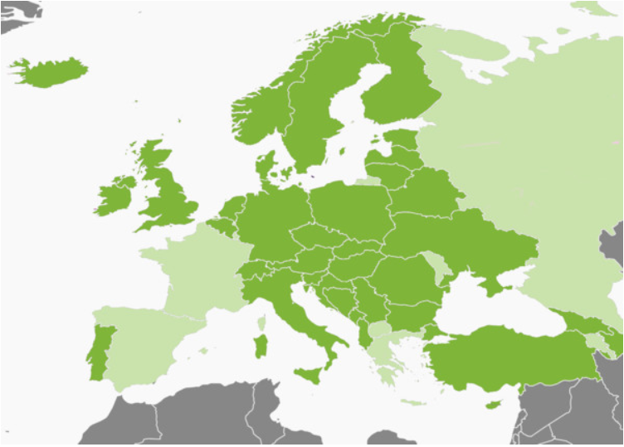
AEGIS – A European Genebank
Integrated System
Conserving in a collaborative way and at agreed quality standards,
the genetically unique and important accessions for Europe of all crops and making them available for breeding and research through SMTAs
35 | Member countries
70+ | Associate Member Agreements
119,000+ | AEGIS accessions
450+ | Genera
The boundaries shown on this map do not imply official endorsement or acceptance by ECPGR
www.ecpgr.org/aegis

Slide 13
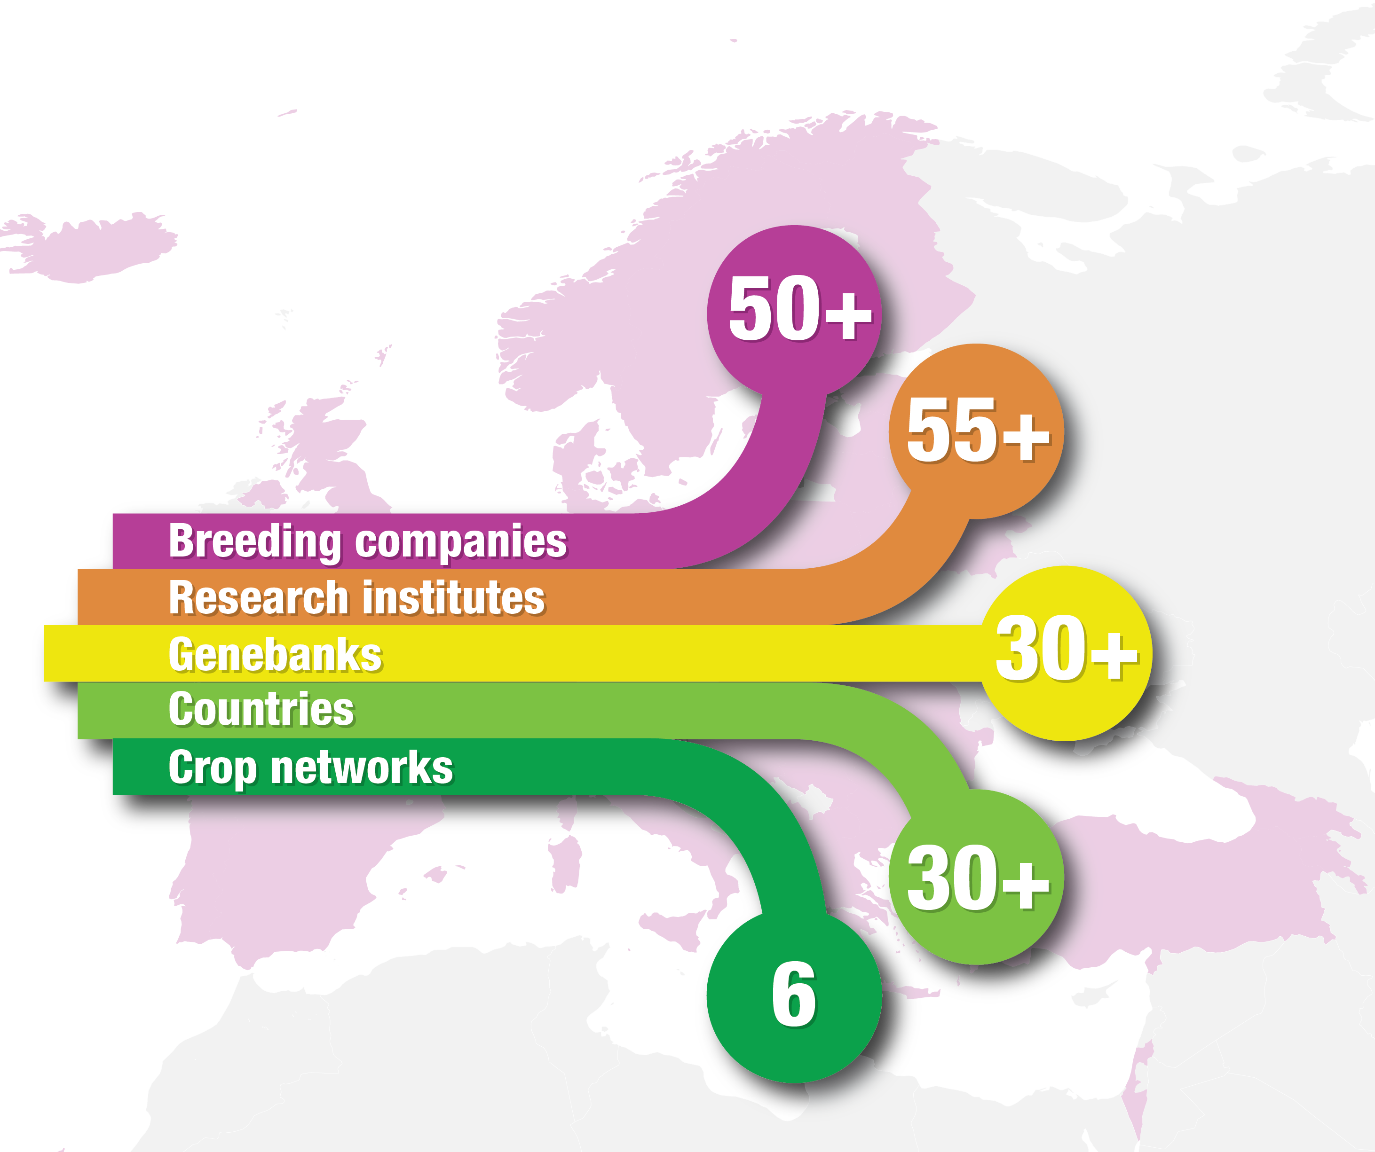



EVA – The European Evaluation Network
Crop-specific public–private partnership networks (currently: carrot, lettuce, legumes, maize, pepper, wheat and barley; a new network on perennial plants in preparation)
Generate standardized multilocation evaluation data
Explore diversity in European genebanks
Promote the use of genebank germplasm in research, breeding and cultivation
www.ecpgr.org/eva
Notes:
EVA has now more than 130 partners, with networks on carrot, lettuce, pepper, wheat, barley and legumes.

Slide 14

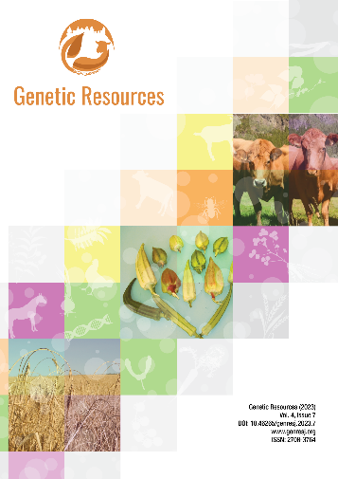



Open-access journal for stakeholders
Diamond open-access journal – free to publish and read
Dissemination of research, opinions and other articles on genetic resources for food and agriculture
Developed within H2020 project GenResBridge
Published by ECPGR and ERFP
www.genresj.org

Slide 15



Genetic Resources Strategy for Europe
Launched in Bruxelles, 30 November 2021
Developed via extensive consultations with experts and stakeholders
Identifies gaps and objectives to guide ECPGR priorities for the next decade
Implementation is subject to firm political will
www.ecpgr.org/pgrstrategy21

