Slide 1
AEG-VIT-IS
Selection and clarification of unsolved identities
Erika Maul
Objectives:
Determination of the true identity of misnomers
Identification of synonymy and homonymy
In grapevine collections the assessment of trueness to type is a long lasting challenge.
In the scope of GrapeGen06 (WP5) and COST Action FA1003 (WP1) procedures to identify questionable accessions were developed.

Slide 2
AEG-VIT-IS
Selection and clarification of unsolved identities
Selection of varieties:
Vitis vinifera accessions that are supposed to be traditional varieties of the country deserve highest priority.
Questionable Vitis vinifera accessions from other countries are accepted as well.
Maximum number: 20 questionable accessions per partner

Slide 3
AEG-VIT-IS
Selection and clarification of unsolved identities
File format includes:
work package
institute code
accession number
accession name
berry colour
coded alleles
Example:
 | Passport Data
Workpackage | 1-INSTCODE | 2-ACCENUMB | 11-ACCENAME | B-BERRY COLOR | VVMD5:1 | VVMD5:2 | VVMD7:1 | VVMD7:2 | VVMD25:1
AEG-VIT-IS | FRA139 | FRA139-64Mtp2 | Mourvèdre N | Black | N+4 | N+18 | N+18 | N+18 | N+6
AEG-VIT-IS | FRA139 | FRA139-25Mtp1 | Furmint B | White | N+4 | N+18 | N+8 | N+18 | N+4
AEG-VIT-IS | FRA139 | FRA139-74Mtp11 | Trebbiano toscano B | White | N+4 | N+10 | N+18 | N+22 | N+6
AEG-VIT-IS | FRA139 | FRA139-284Mtp4 | Veltliner rot RG | Red | N+18 | N+24 | N+8 | N+22 | N+4
etc.

Slide 4
AEG-VIT-IS
Selection and clarification of unsolved identities
Genetic profiles encompass the 9 GrapeGen06 SSR-markers:
VVS2, VVMD5, VVMD7, VVMD25, VVMD27, VVMD28, VVMD32, VrZag62, VrZAG79 (and others if available are welcome)
alleles have to be coded to ensure comparability
if necessary a macro will be provided for coding
Part of the coding table:
Enter the size of the alleles (Columns in yellow) obtained in you lab (ex. 122, 124) in front of the code in the red columns.
Do not modify the red columns.
For the correspondance between the sizes and the codes, please refer to reference cultivars data (raw and coded)
http://www.montpellier.inra.fr/grapegen06/extranet/menu_activities_room_index/page_wpI/wpI.html
Your data | Inra data | CODE | Your data | Inra data | CODE | Your data | Inra data | CODE
VVS2 | VVS2 | VVS2 | VVMD5 | VVMD5 | VVMD5 | VVMD7 | VVMD7 | VVMD7
 | 33C1 | N |  | AL1 | N |  | FE1 | N
 | VIA1 | N+2 |  | CF1 | N+4 |  | MU1 | N+2
 | 4MG1 | N+4 |  | MU1 | N+6 |  | VIA1 | N+4
 | RO1 | N+6 |  | MAU1 | N+8 |  | JA1 | N+6
 | VE1 | N+8 |  | TR1 | N+10 |  | CF1 | N+8
 | BA1 | N+10 |  | CH1 | N+12 |  | TR1 | N+12
 | BA2 | N+12 |  | MU2 | N+14 |  | 33C1 | N+14
 | CH1 | N+14 |  | CH2 | N+16 |  | ME2 | N+16
 | CF1 | N+16 |  | CF2 | N+18 |  | MU2 | N+18
 | 16C02 | N+18 |  | JA2 | N+22 |  | FE2 | N+20
 | CH2 | N+20 |  | VE2 | N+24 |  | SU2 | N+22
 | SU1 | N+22 |  | 33C1 | N+30 |  | PO2 | N+24
 | CF2 | N+24 |  | 1MG1 | N+34 |  | TR2 | N+26
 | 99R2 | N+26 |  | GO1 | N+40 |  | 33C2 | N+28
 | SI1 | N+28 |  | 33C2 | N+42 |  | 99R2 | N+30
 | SI2 | N+30 |  | 1MG2 | N+44 |  | CF2 | N+32
 | MAR2 | N+32 |  | 11R2 | N+46 |  | 5C2 | N+34
 | MAN2 | N+34
 | 33C2 | N+38

Slide 5
AEG-VIT-IS
Selection and clarification of unsolved identities
Step 1:
Preparation of the excel sheet with questionable genotypes according to the requested file format
Coded alleles are required (if necessary the macro from Patrice This will be provided)
Filled excel sheet will be sent to Gregorio.
Deadline ?

Slide 6
AEG-VIT-IS
Selection and clarification of unsolved identities
Step 2:
Gregorio will copy all data in one excel file.
He will send this table to all partners.
Deadline ?

Slide 7
AEG-VIT-IS
Selection and clarification of unsolved identities
Step 3:
Partners will search for matching genetic profiles in their own SSR-marker-databases.
If corresponding profiles were detected, partners search for any available information, e.g. descriptions, photos, bibliographic references.
The partners send the identification results plus documentation material to Gregorio and to the concerned partners for ampelographic verification of the discovered identities.
Deadline ?

Slide 8
AEG-VIT-IS
Selection and clarification of unsolved identities
Step 4:
Compilation of the results by Gregorio, according to WP5-table of GrapeGen06, see below.
Gregorio will send this table to the partners and await the partners’ statements to the discovered identities.
Exchange of findings and opinions between concerned partners, proposition of the true variety name.
Example:
Questionable ACCENAME | Institute code | 2-ACCENUMB | Berry color | Proposed identities | Remarks on identity | True name | Cultivars' origin or presumed origin | References for morphological profile (bibliography, photos, descriptions) | MD5 | MD5 | MD7
Bonarda di Chieri (faux) | FRA139 | FRA139-0Mtp143 | blue black |  | known misnomer | Durasa (ITA cat.) | Italy | none
 | ITA360 | ITA360-526 | blue black | Durasa | true name |  |  |  | N+4 | N+18 | N+22
 | ITA361 | ITA360-060 | blue black | Erbaluce nero | local synonym
etc.
Deadline ?

Slide 9
AEG-VIT-IS
Selection and clarification of unsolved identities
Step 5:
Gregorio will collect all data and establish two final lists:
(1) identified varieties
(2) still questionable varieties.
Deadline ?

Slide 10
AEG-VIT-IS
Selection and clarification of unsolved identities
Step 6:
New genotypes will be registered in VIVC.
MCPD-Data, genetic profiles, etc. will be uploaded in the European Vitis Database
Deadline ?

Slide 11
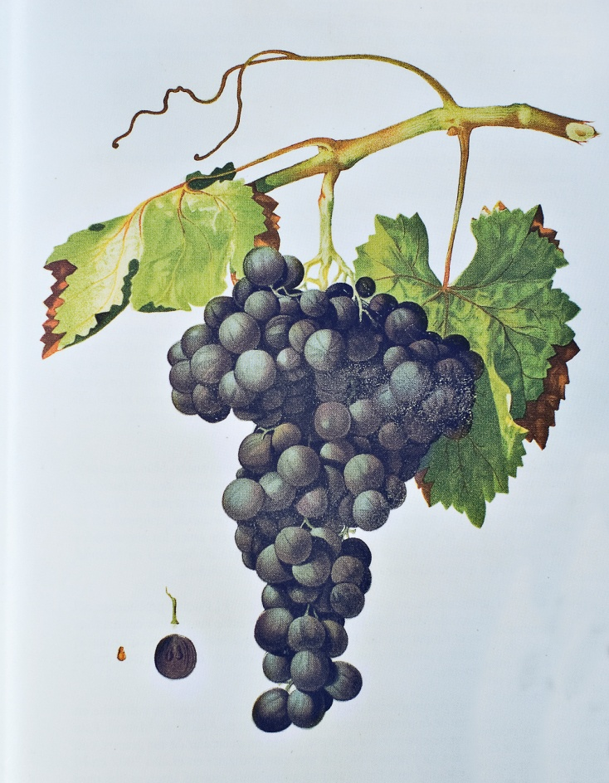
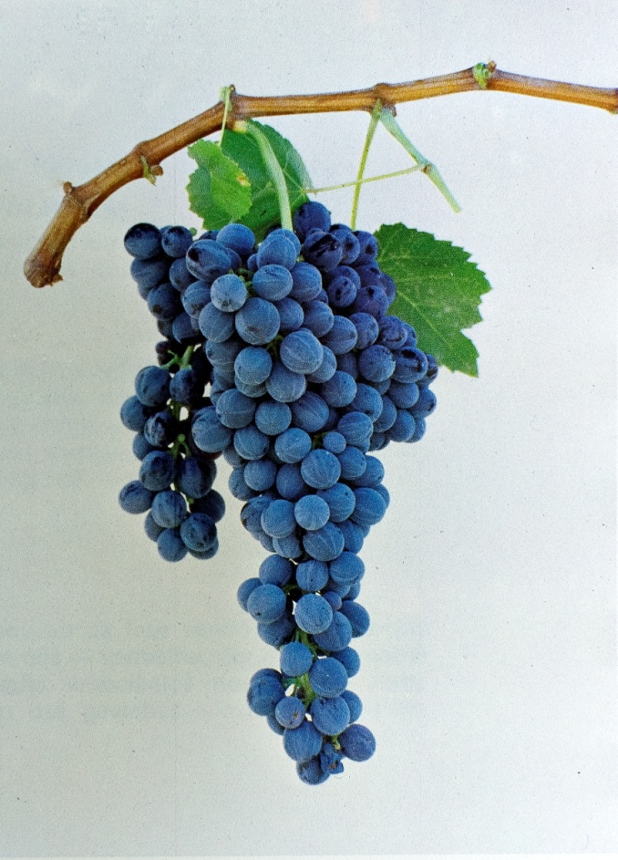
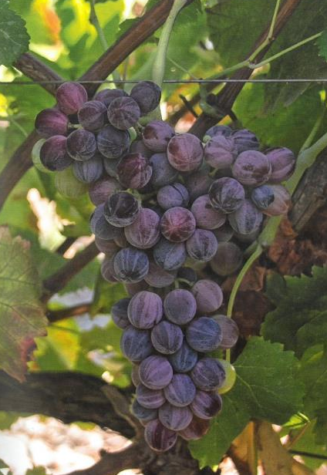
AEG-VIT-IS
Selection and clarification of unsolved identities
Good luck!
Drawing of Rayonada Melonera :
F.C. Saenz de Santa Maria, G. Munoz Organero, A. Benito Barba, S. Garcia Beneytez, J.A. Diez de Rivera, Simón de Rojas Clemente (1777-1887), 200th anniversary of a milestone in viticulture research. Consejeria de Economía y Consumo Comunidad de Madrid (2008)
Photo of Corropio:
J.A. de Oliveira e Silva, Regiao do Alenteijo. Instituto Gestao e Estruturacao Fundaria (1986)
Photo of Albaranzeuli Variegat:
AKINAS – Uve di Sardegna (2017)
Thank you for your attention

