Slide 1


AEG-VIT-IS
Country: Spain
List of Unique genotypes candidates for AEGIS and safety duplications
146 Unique genotypes selected in a first step
133 having into account common genotypes with other countries (Portugal, France, Italy)
All genotypes in this first list are duplicated in other repositories
Unsolved identities
19 genotypes found in two or more locations in Spain and without a local name
they are different (by SSR) to the known genotypes

Slide 2
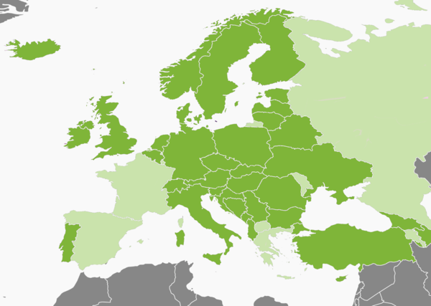
AEG-VIT-IS
Country: Spain
Comments
Spain is not member of AEGIS at this moment, but it is intended to be member in a short term
A first list of candidates have been selected for flagging in AEGIS when posible
An operational Genebank Manual is being prepared at IMIDRA

Slide 3
AEG-VIT-IS
Country: Spain
Comments
What to do when genotypes have synonyms in other countries?
Brancellao (Spain) Alvarelhao (Portugal)
Bruñal (Spain) Alfrocheiro (Portugal)
Doña Blanca (Spain) Siria (Portugal)
Godello (Spain) Gouveio (Portugal)
Merenzao (Spain) Trousseau Noir (France)
Legiruela (Spain) Agostenga (Italy)
Garnacha Tinta (Spain) Grenache Noir (France) Cannonau (Italy)
Is possible to list the same genotype by different countries?
If not, it should be listed by the country of origin

