Slide 1

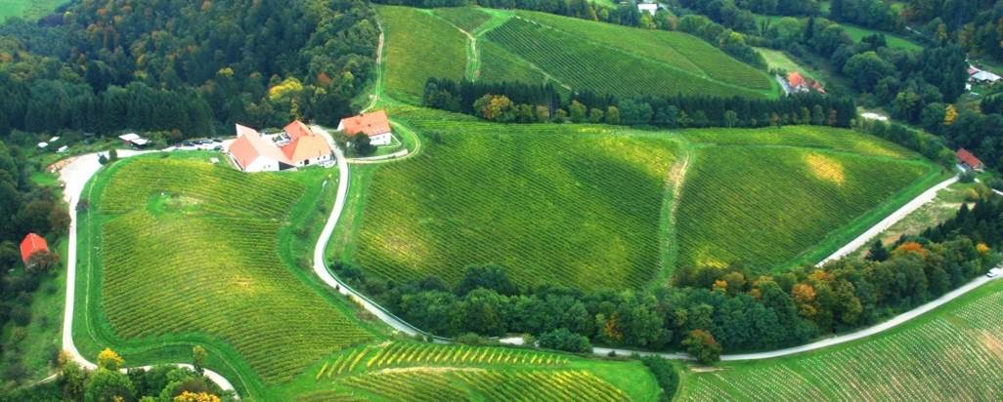
Country: Slovenia
http://meranovo.um.si
AEG-VIT-IS
List of Unique genotypes candidates for AEGIS and safety duplications
(Outline the number of unique genotypes candidates for AEGIS in your country having into account the Guidelines.
Indicate the number of candidates with safety duplications in other(s) repositorie(s))
SVN043
424 accessions, 380 acc. in VIVC, 44 not identified

Slide 2
Country: Slovenia
http://meranovo.um.si
AEG-VIT-IS
Na | Variety |  | VIVC
SVN043-14 | ZELEN | BLANC | 13412
SVN043-16 | POLJSAKICA | BLANC | 17712
SVN043-17 | KLARNICA | BLANC | 40687
SVN043-18 | VITOVSKA GRGANIJA | BLANC | 16017
SVN043-19 | PERGOLIN | BLANC | 17707
SVN043-42 | RANINA | BLANC | 1625
SVN043-50 | RANFOL | BLANC | 9908
SVN043-53 | PORTUGALKA | NOIR | 9620
SVN043-57 | ZAMETOVKA | NOIR | 6047
SVN043-58 | FRANKINJA | NOIR | 1459
SVN043-64 | VRTOVKA | BLANC | 17737
SVN043-65 | SLADKOCRN | NOIR | 17721
SVN043-66 | CUNDRA | BLANC | 17669
SVN043-68 | VERBENA | BLANC | 17735
SVN043-69 | PLANINKA | BLANC | 17711
SVN043-71 | ZUNEK | BLANC | 17739
SVN043-330 | ZELENEC | BLANC | 26014
SVN043-331 | VRBOVEC | BLANC | 26015
SVN043-332 | PECEK | BLANC | 3865
SVN043-333 | BELINA | BLANC | 5374
SVN043-363 | PIKA | BLANC
SVN043-364 | TRZARKA | BLANC
SVN043-365 | SUSC | BLANC
SVN043-366 | POGROZNICA | BLANC
SVN043-367 | ZELENIKA | BLANC
SVN043-368 | CENCUKNA | BLANC
SVN043-369 | SEVKA | BLANC
SVN043-370 | POKALICA | NOIR
SVN043-362 | M 14/2 | BLANC

Slide 3
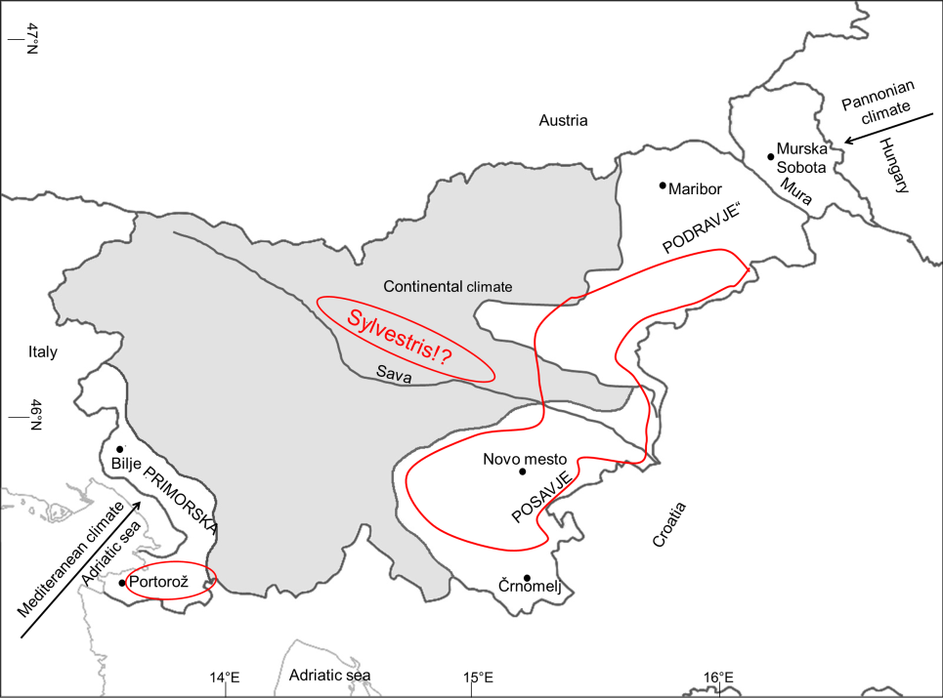
Country: Slovenia
http://meranovo.um.si
AEG-VIT-IS
Molecular analysis: in 2019, 164 samples (17 sylvestris???)
22 of them - not identified (T. L. team)
Collected in 2020:
232 samples (potentially
49 V. sylvestris)
January 2021, Geiweilerhof
V. sylvestris 2019 and 2020: 86 plants, 66 samples

