Slide 1
AEG-VIT-IS
Country: Serbia
List of Unique genotypes candidates for AEGIS and safety duplications
Dragan Nikolić, University of Belgrade, Faculty of Agriculture
Dragoslav Ivanišević, University of Novi Sad, Faculty of Agriculture
Total number of unique genotypes candidates for AEGIS in Serbia = 580
From Serbia = 127
Other countries = 453
For all genotypes are given name of Variety/Accession, VIVC Prime name and VIVC number
Registered in the country = 549
Unregistered in the country = 31
Registered in other EU country = 546
Unegistered in other EU country = 34
Origin outside of EU, having high value for EU = 205
Origin inside of EU = 375
Holding Collection (SRB016 and SRB087) = 580
Safety duplication in other collection = 291

Slide 2
Landrace of domestic origin = 62
Wild of domestic origin = 0
Breeding of domestic origin = 56
Passport data available = 580
Ampelographic data
available = 567
unavailable = 13
Pictures
available = 567
unavailable = 13
Molecular data available = 0

Slide 3
Agronomical data
available = 492
unavailable = 88
Enological data
available = 234
unavailable = 346
Other characteristics of interest
Yes =0
No = 580
Virus free
Yes = 580
No = 0

Slide 4
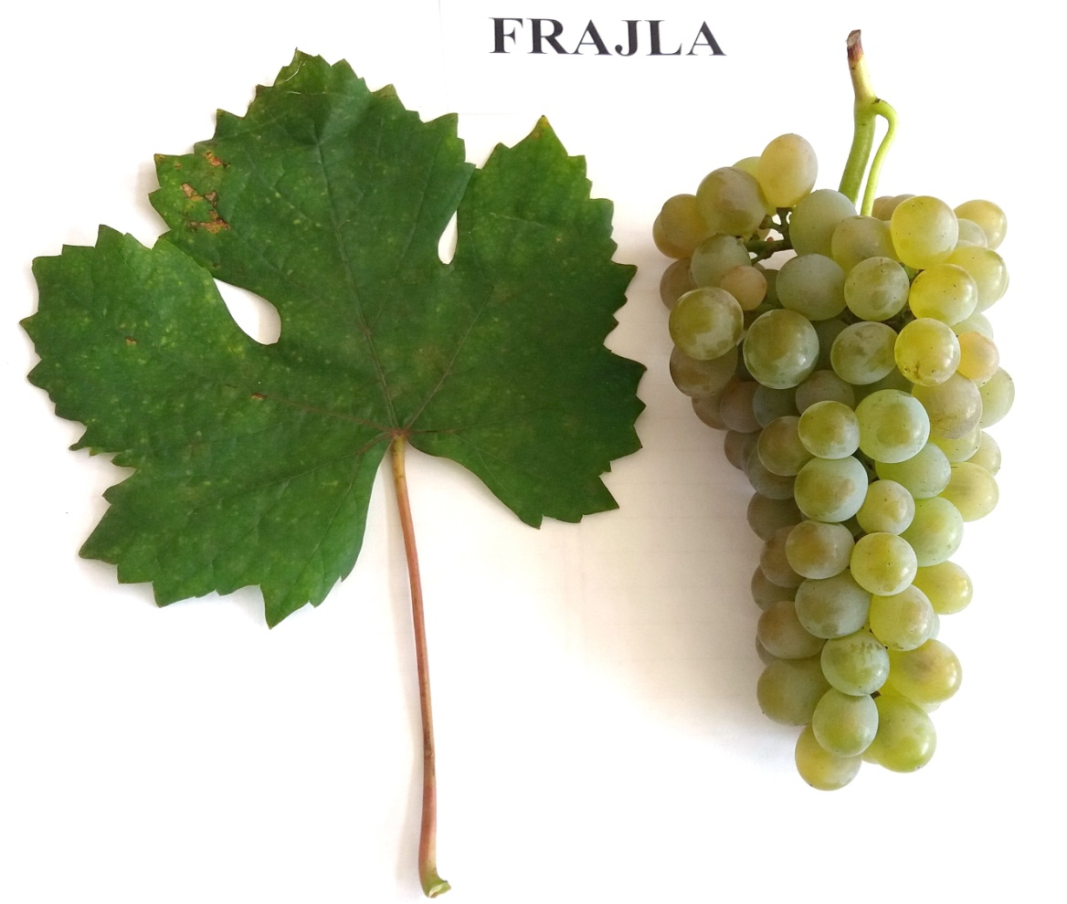
Unsolved identities
Name (true to type)
validated = 567
unvalidated = 13
Frajla

Slide 5
Comments
Future plans:
Molecular characterization of all genotypes
Ampelographic, agronomical and enological analysis of remaining genotypes
Identity solve for 13 genotypes

Slide 6
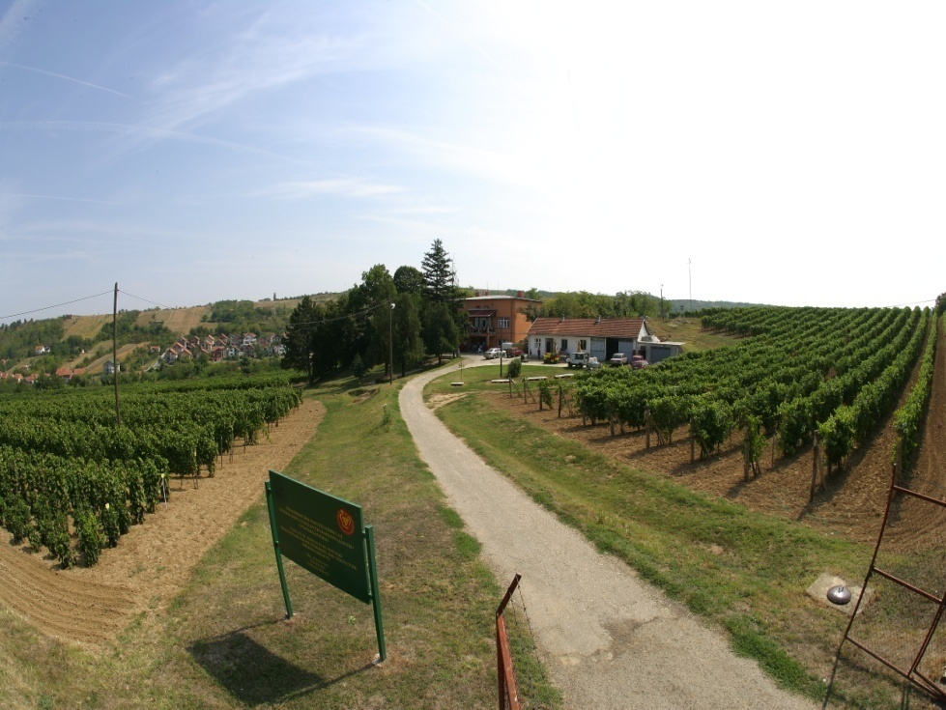
THANK YOU FOR YOUR ATTENTION

