Slide 1
AEG-VIT-IS
Country: North Macedonia
List of Unique genotypes candidates for AEGIS and safety duplications
Klime Beleski
Ss. Cyril and Methodius University in Skopje, Institute of Agriculture
Total number of unique genotypes candidates for AEGIS in North Macedonia - 140
From North Macedonia - 20
Other countries - 120
Registered in the country - 93
Unregistered in the country - 47
Registered in other EU country - 115
Unegistered in other EU country - 25
Origin outside of EU, having high value for EU - 5
Origin inside of EU - 135
Holding Collection (MKD 01) - 140
Safety duplication in other collection - 40

Slide 2
Landrace of domestic origin - 10
Wild of domestic origin - 0
Breeding of domestic origin - 0
Passport data available - 140
Ampelographic data
available - 140
unavailable - 0
Pictures
available - 100
unavailable - 40
Molecular data available - 10

Slide 3
Comments
Future plans:
Ampelographic, agronomical and enological analysis of remaining genotypes

Slide 4
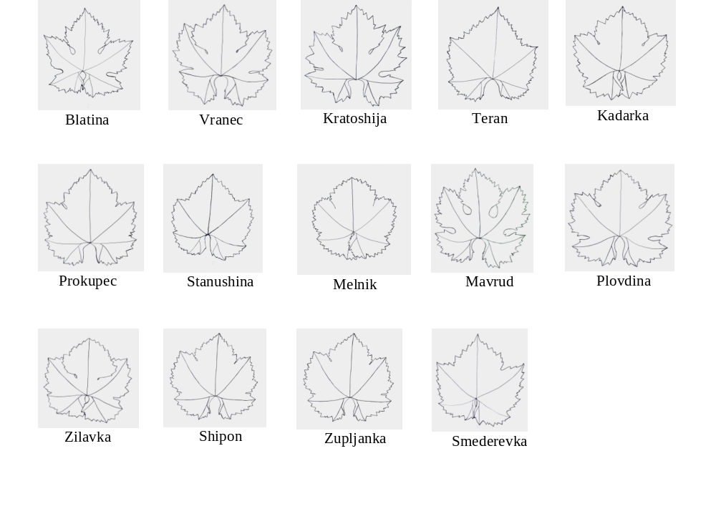
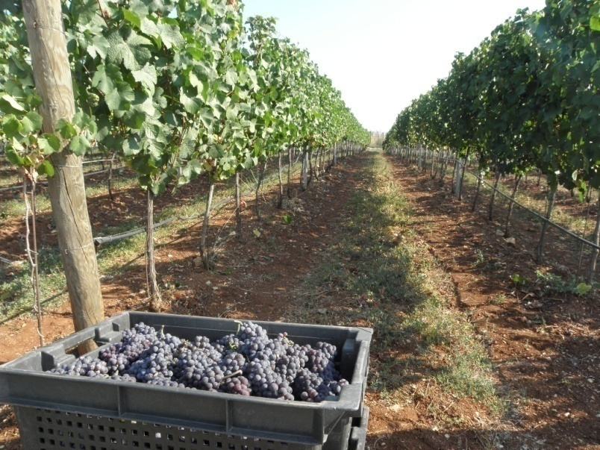
Thank you for your attention!

