Slide 1

Enhancing quality and quantity of Vitis genetic resources in AEGIS
AEG-VIT-IS
prof. dr Vesna Maraš
Montenegro
November, 2020

Slide 2
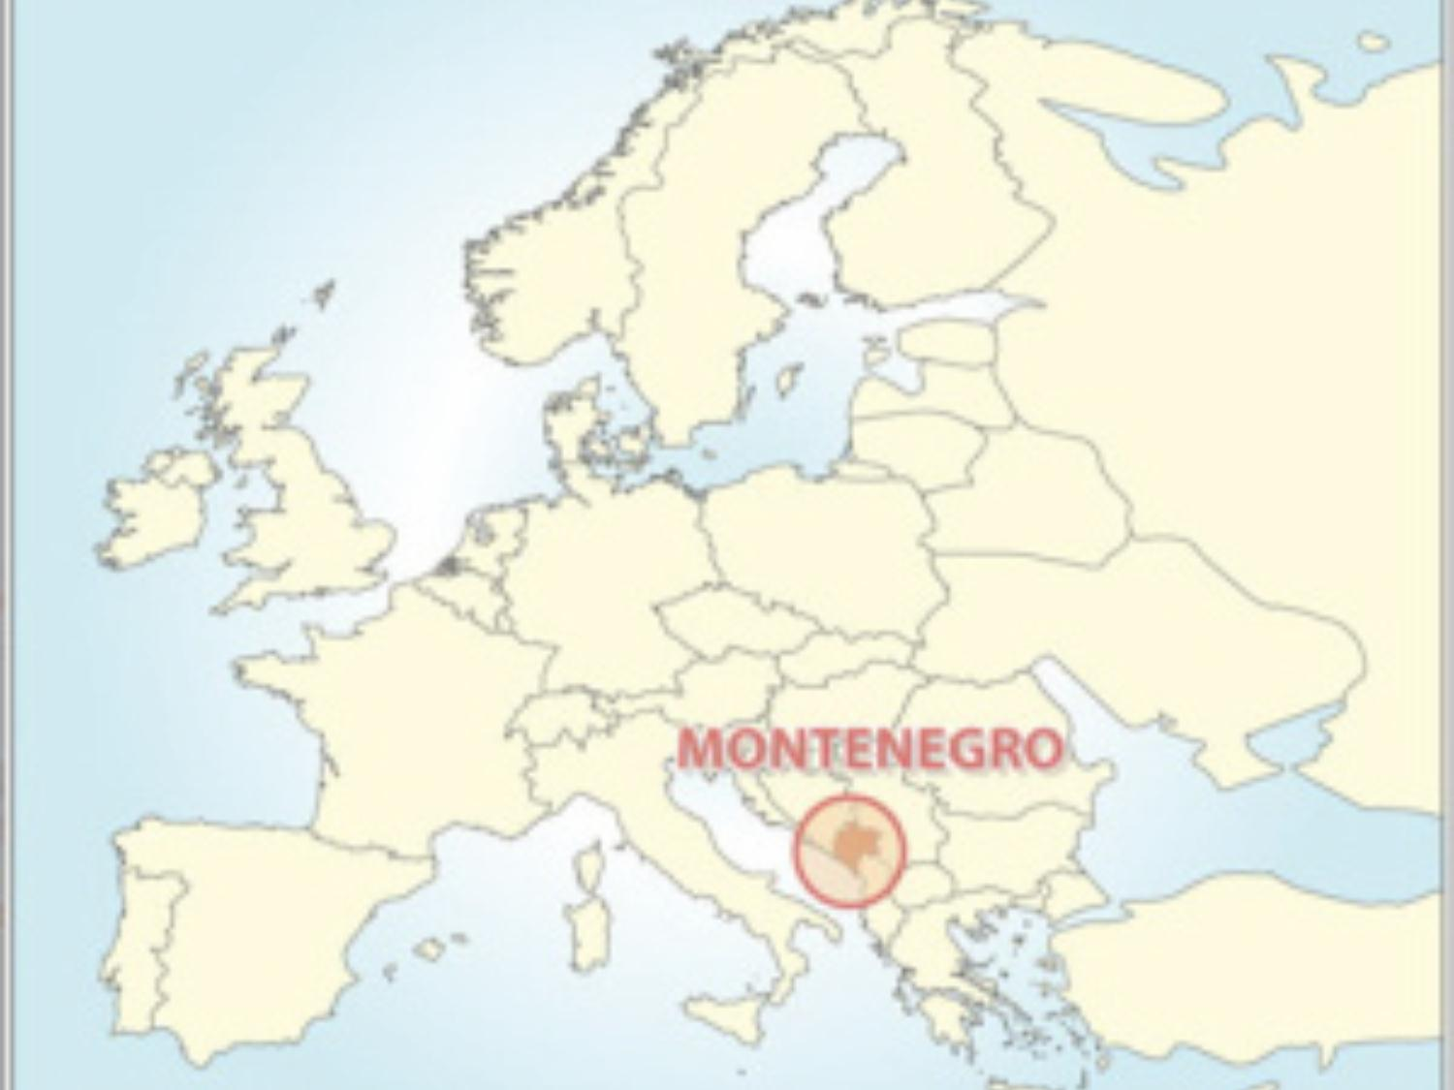


MONTENEGRO
COUNTRY OF GREAT WINES
Size: 13 812 km²
Population: 620 029
Length of the coast: 316 km
Montenegro is a candidate country for membership of the EU

Slide 3

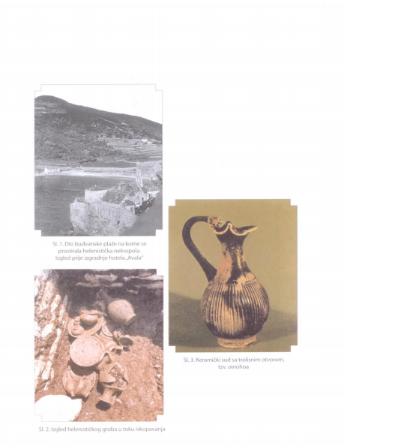

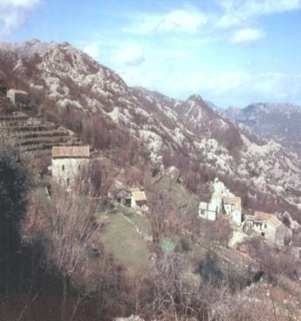
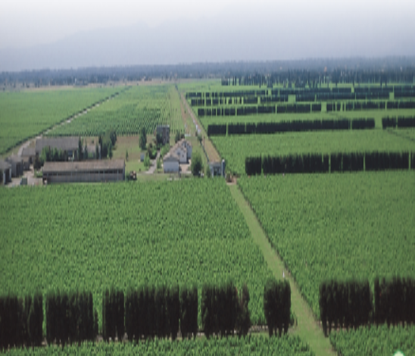
The culture of grapevine growing in Montenegro dates back from the Hellenistic period
For centuries wine has been a part of Montenegrin tradition, religion, culture and customs
Autochthonous grapevine varieties (dominant)
Climate and soil (terroir) - very favourable for the production of grapes and wine

Slide 4

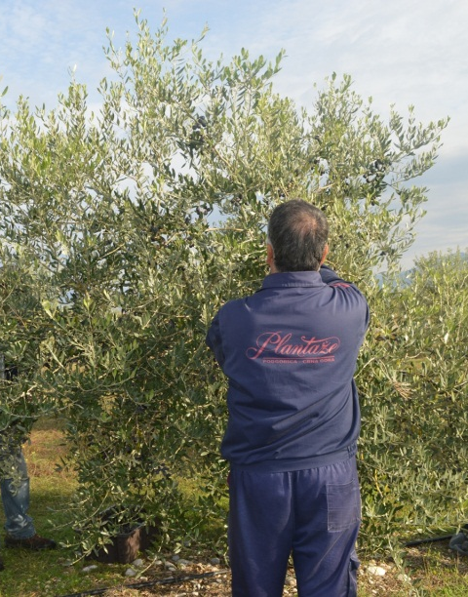


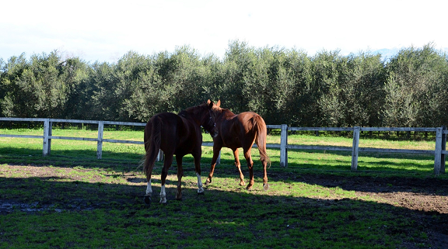
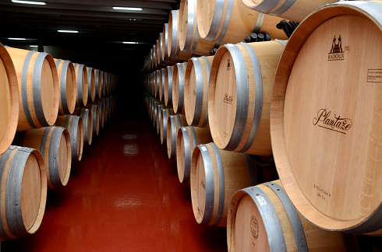
"13. jul Plantaže "a.d. -
the biggest producer of grapes and wines in Montenegro
The largest vineyard in Europe in one complex with a surface of 2310 ha
About 11 million of vines
22,000 t of table and wine grapes
1.5 million kg of peach
10 000 olive trees
1 million vintage grafts
100 tons of trout
3 wine cellars: "Ćemovsko Field", "Lješkopolje" and "Šipčanik" with a production capacity of 30 million liters of wine
17 million bottles of wine and brandy
2 restaurants "Mareza" and "Jezero"
Retail stores
Equestrian Club Montenegro

Slide 5

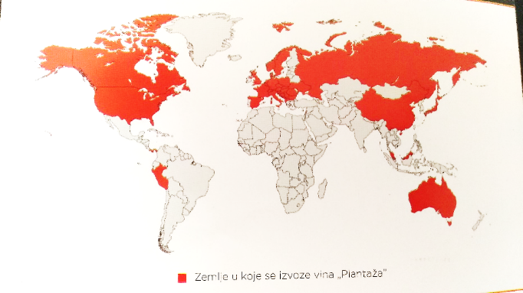

The market leader in the region
export to 43 countries around the world
over than 1000 international and domestic awards
Only in year 2017 more than 40 gold and silver medals were achieved at international trade fairs, such as:
Decanter World Wine Awards London
Decanter Asia
AWC Vienna
BIWC Bulgaria
Mundus Vini Germany
Vino Ljubljana.
Wine exporting countries of Plantaže

Slide 6

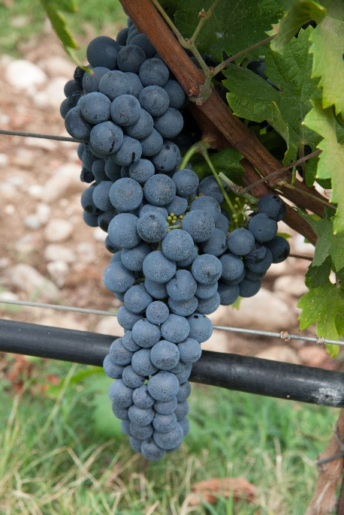
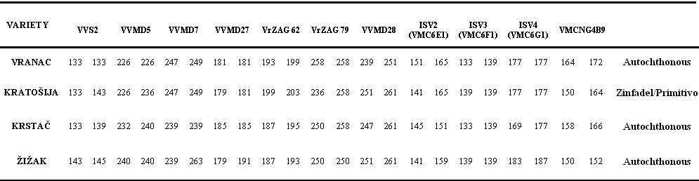
Appreciating the importance of the grapevine germplasm and its importance for the viticulture and wine sector not only for Montenegro, but also for the global biodiversity and its preservation, the company "13. jul Plantaže“ has participated in the numerous international projects and networks in order to contribute to the preservation and revitalization of Montenegrin indigenous grape varieties.
In the period (2004-2008) in cooperation with Italian partners (Instituto Sperimentale per la Viticultura-Susegana-Conegliano (TV) was done the identification of Montenegrin autochthonous grape varieties.
Antonio Calò, Angelo Costacurta, Vesna Maraš, Stefano Meneghett and Manna Crespan (2008): Molecular Correlation of Zinfandel (Primitivo) with Austrian, Croatian, and Hungarian Cultivars and Kratosija, an Additional Synonym American Journal of Enology and Viticulture, Am. J. Enol. Vitic. 59:2:205-209. Davis, CA, USA.
Notes:
6

Slide 7




REALIZED PROJECTS:
SEEDnet project (2009-2010) - ''Identification, characterisation and conservation of old and autochthonous vine varieties in eastern european countries'’
SEE.ERA.NET project (2010-2012) ''Preservation and establishment of true-to-type and virus free material of endangered grapevine cultivars in Croatia and Montenegro'' ERA 91/04
As a result of the work on the characterization of the Montenegrin grapevine germplasm, within the mentioned projects, Montenegro is the first time in 2012. presented its autochthonous varieties and officially joined the EU Vitis database.
COST ACTION FA1003 (East-West Collaboration for Grapevine Diversity Exploration and Mobilization of Adaptive Traits for Breeding) (2012-2014)
ECPGR group ''Increasing the efficiency of conservation of wild grapevine genetic resources in Europe – InWiGrape project (2016)
ECPGR group “On-farm inventory of minor grape varieties in the European Vitis Database – GrapeOnFarm (2017)
Project "Genetic diversity of vines in Montenegro", in cooperation with Institute of Vine and Wine (ICVV) in La Rioja, Spain (2013 - ongoing)
COST action CA17111 – Data integration to maximize the power of omics for grapevine improvement (2018-2022)

Slide 8
AEG-VIT-IS
The most comprehensive study on the grapevine diversity in Montenegro, ’’13. jul Plantaže ’’ realised from 2013., and still ongoing, in the cooperation with Institute of Vine and Wine from Spain - ICVV (Logroño, La Rioja) led by prof. dr Jose Miguel Martínez Zapater and dr Javer Ibanez, with the participation of dr Rafael Ocete from Faculty of Biology, University in Sevilla, Spain and prof. dr Miodrag Grbić from University of Western Ontario, in Canada and dr Nataša Štajner from Biotechnical Faculty, University of Ljubljana.
The main goal of this research was to perform the genetic characterization of the existing genetic diversity of vines in cultivated and wild populations of Vitis vinifera (L.) in Montenegro, with the aim of defining the importance of autochthonous grapevine varieties in Montenegrin viticulture, and its genetic relashionships.
Extensive search for grapevine diversity was concentrated on well-known vineyard sites with special attention to traditional wine-growing regions of Montenegro. The research of cultivated plants was focused exclusively on old vines (from 50 to 300 years old) located in small vineyards or orchards, which mostly belong to local grape and wines growers, produced for own consumption. Wild vine samples were mostly collected near the banks of rivers or streams across the country.

Slide 9
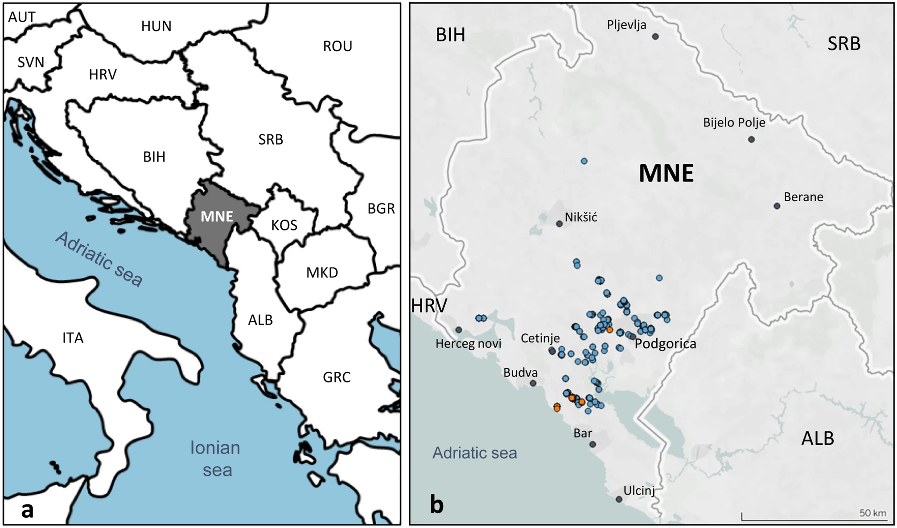
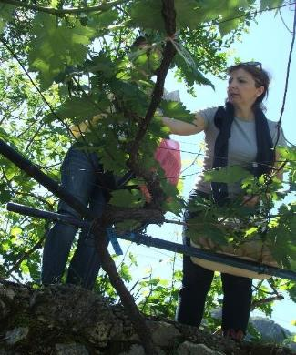
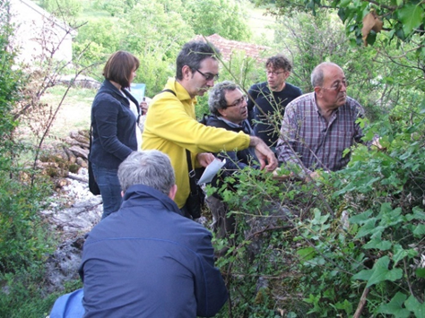
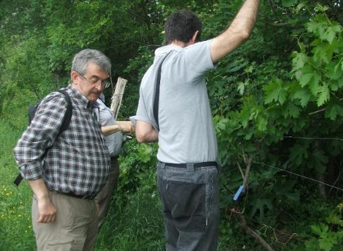
Within the research, 476 vines from all wine-growing regions of Montenegro were localized, georeferenced and analysed.
419 vines (379 vines grown in old vineyards, Vitis vinifera ssp. sativa and 45 vines that grow wild in nature, assuming that they belong to the wild vine - sylvestris) were isolated from the vineyards of Montenegro.
The research also included 57 samples that are currently maintained in the collection of grapevine genetic resources (ex situ Vitis collection of the Biotechnical Faculty of the University of Montenegro - BTF collection), as reference genotypes and possible representatives of ancient varieties that are not currently grown.
Location of Montenegro in the Western Balkans (a) and sampling sites of cultivated and wild grapevines in Montenegro (b).

Slide 10
AEG-VIT-IS
Selected vines were sampled and genotyped using SNP (single nucleotide polymorphisms) and SSR markers (simple sequence replicates), and unique genetic profiles were compared with international databases to properly identify varieties and detect synonyms (different names for one variety) and homonyms. same name for different varieties).
The DNA of each vine was analyzed at ICVV (Institute for Vine and Wine-La Rioja, Spain) and compared with their base of SNP molecular markers, which is unique in its size worldwide. In addition, we analyzed the genetic diversity and structure of vines in Montenegro and studied their genetic links.
In this way, 144 different genetic profiles were confirmed, among which 101 genotypes corresponding to cultivated varieties (Vitis vinifera ssp. Sativa), and 43 genotypes, corresponded to wild forms (Vitis silvestris).
Accordingly, 2 clusters were formed and analyzed, namely a cluster of cultivated grape varieties and a cluster of wild vines in Montenegro.

Slide 11









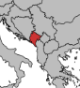


















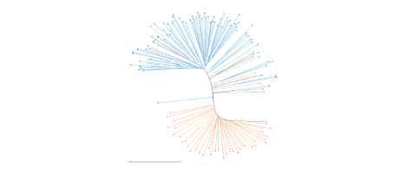


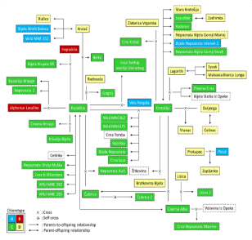
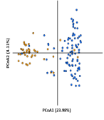
V. Maraš¹, J. Tello², A. Gazivoda¹, M. Mugoša¹, M. Perišić¹, J. Raičević¹, N. Štajner³, R. Ocete⁴, V. Božović⁵, T. Popović⁶, E. García-Escudero², M. Grbić⁷, J. M. Martínez-Zapater^{2,} J. Ibáñez²
¹13 Jul Plantaže; ² Departamento de Viticultura, Instituto de Ciencias de la Vid y del Vino (CSIC, UR, Gobierno de La Rioja) ; ³ Biotechnical Faculty, Agronomy Department, University of Ljubljana; ⁴ Laboratorio de Entomología Aplicada, Facultad de Biología, Universidad de Sevilla; ⁵ Faculty for Food Technology, Food Safety and Ecology, University of Donja Gorica; ⁶ Biotechnical Faculty, University of Montenegro; ⁷ Department of Biology, University of Western Ontario
43 wild
genotypes
51
unidentified
cultivars
9 SSRs
48 SNPs
144
genotypes
476
samples
101
cultivated
genotypes
&
MNE
50
identified
cultivars
SNPs and SSRs profiles allowed us to identify multiple cultivars from the Balkans and foreign cultivars from Eastern and Western regions
A complex parentage network linking many autochthonous varieties, was found, where two varieties (Razaklija and Kratošija) played a leading role on the generation of indigenous varieties
Kratošija (107)
Vranac (76)
Lisica (35)
Razaklija (27)
Krstac (22)
Zlatarica Vrgorska (8)
Čubrica (5)
Kadarun (5)
Bratkovina Bijela (4)
Sura (4)
Chaouch Blanc (4)
Vela Pergola (4)
Belka (3)
Isabella (3)
Koenigin Der Wein. (3)
N. Bijela Brijestovo (3)
Prokupac (3)
Vulpea (3)
Coarna Alba (2)
Crni Krstač (2)
Loza S. V. Ostrozkog (2)
Muscat Hamburg (2)
Plavina Crna (2)
…
UwNJ distance tree and PCoA analyses revealed two main clusters of grapevine genotypes, which majorly reflected the sampling origin (cultivated - wild) of the samples

Slide 12
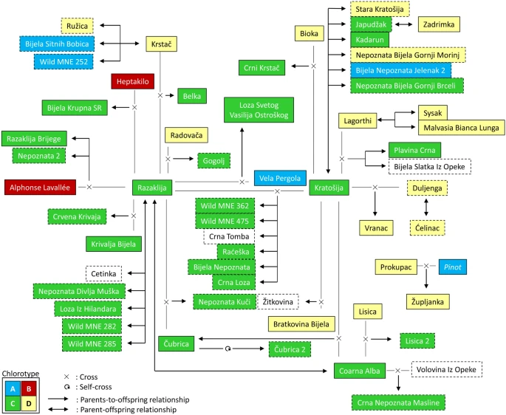
The results of the research confirmed that Montenegrin viticulture is based on a family of genetically related varieties, what is characteristic in other famous traditional regions for growing vines and wine production.
In Montenegro, this family was mainly created around the Kratošija variety. Kratošija is at the center of Montenegrin viticulture such as Cabernet franc and Pinot noir in the center of Bordeaux and Burgundy.
Kratošija is also the oldest variety that was grown in Montenegro, it has almost 20 offsprings in Montenegro and it is the parent of the Vranac variety.
In addition to Vranac, some of the descendants of Kratošija in Montenegro are Čubrica, Raćeška, Žitkovina, Crni Krstač, Crna loza, Crna Tomba and others.
In this study, we found the full pedigree of Vranac and determined that it is a descendant of Duljenga and Kratošija, and in the best way confirmed its autochthony and origin.
First-order genetic relationships (trios and duos) detected for cultivated and wild grape varieties sampled in Montenegro. Chlorotypes (A, B, C or D) are indicated with different colors, according to the inserted code.

Slide 13
The results of this study reveal 51 unidentified (unknown) genotypes of the grapevine, which represent potentially new varieties.
9 of them (Crni Krstač, Belka, Loza Sveti Vasilije Ostroški, Nepoznata Bijela Brijestovo, Bijela krupna SR, etc.) were found in at least two locations, which confirms that they are vegetatively propagated, that they are grown as local varieties and that they are on the risk of extinction.
It is interesting that it was determined that some of the unidentified genotypes are descendants of other known local varieties (eg Belka is a descendant of Razaklija and Krstač, Crni Krstač is a descendant of Kratošija and Bioka), which indicates their Montenegrin origin.
The remaining 42 unidentified genotypes appeared only once in the sampling of cultivated varieties:
28 on the vineyards of Montenegro (Bijela nepoznata, Bijela Nepoznata Jelenak, Crna Loza, Crna nepoznata Crmnica, Crna nepoznata Masline, Bijela nepoznata Gornji Brčeli, Bijela nepoznata Gornji Morinj, Nepoznata Brijege, Nepoznata Kosić, Nepoznata Kuči, Nepoznata Piperi, etc.),
14 were found only in the collection of the Biotechnical Faculty under the names Bijela bezimena, Bijela sitnih bobica, Volovina iz Opeke, Cetinka, Crna Tomba, Ćelinac, Duljenga, Jasenka and others.
Some of them may also represent autochthonous varieties, which is indicated by the genetic identification of the offsprings for some of these varieties (eg Crna Nepoznata Masline is a offspring of the Volovina iz Opeke).

Slide 14
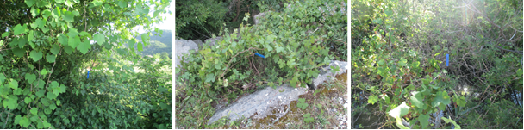
AEG-VIT-IS
Analysis of wild grapevine population (Vitis sylvestris)
All samples – 43 - shown an unique profiles.
There are some plants grown in old vineyards, but from a genetic point of view,discovered that they are completely wild - sylvestris (Kratošija put ka Zagarču and Nepoznata Crmnica).
6 individuals were investigated as wild vines, and the results show that they have a higher sativa than sylvestris genetic composition: two with a very significant (Wild MNE 362 and Wild MNE475) and four with a significant share (Wild MNE 361, Wild MNE 476, Wild MNE 285 and Wild MNE 282)
Samples of cultivated plants with similar percentages of sativa and sylvestris origin of genetic subgroups were also found. Bijela Nepoznata Jelenak, Loznica-2, Cabernet Franc and Savagnin (synonym Traminer) are believed to be examples of active mechanisms of introgression of genomic regions (genes) from sylvestris to new varieties.

Slide 15
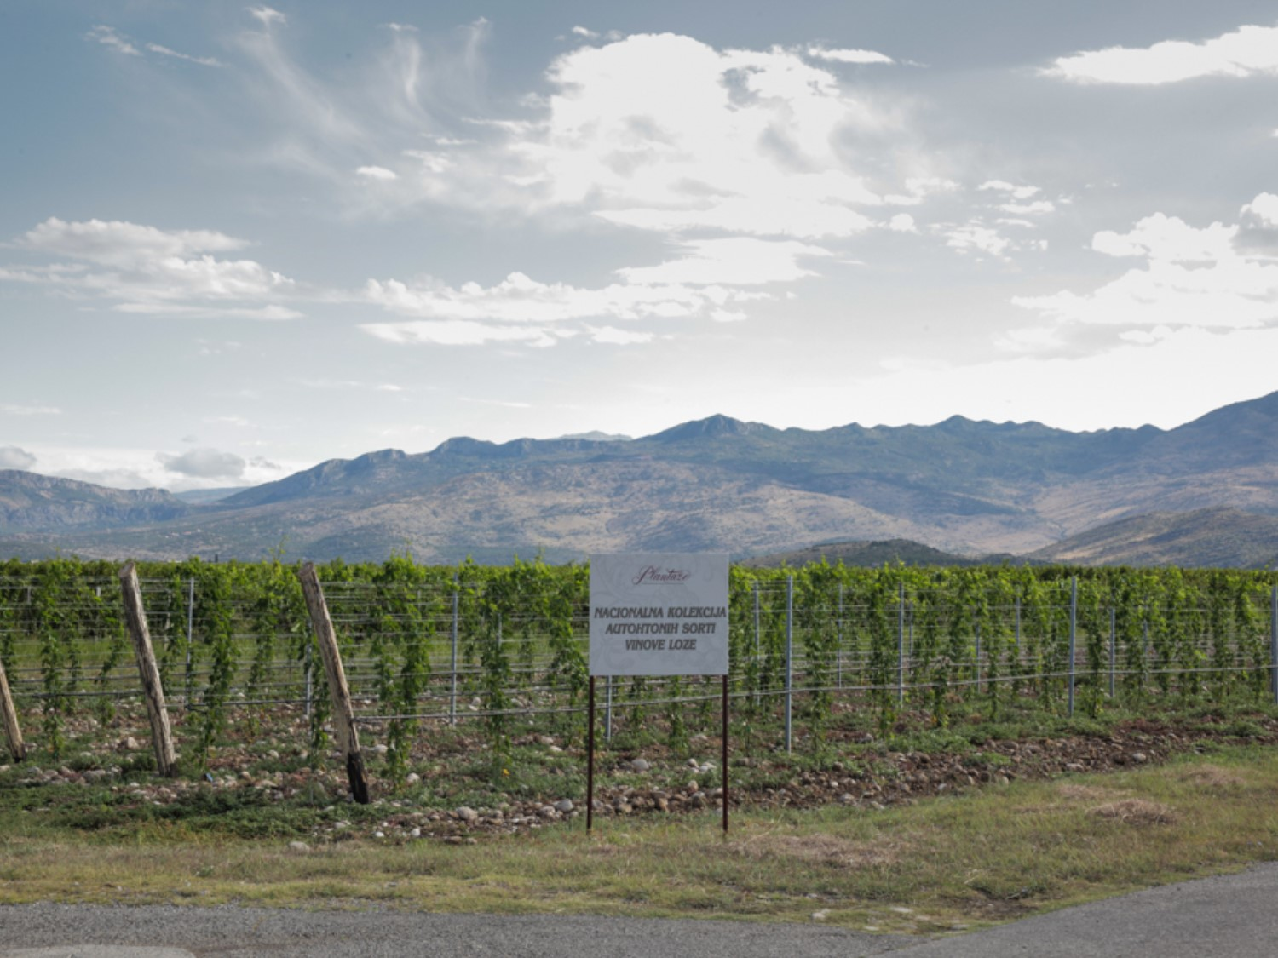
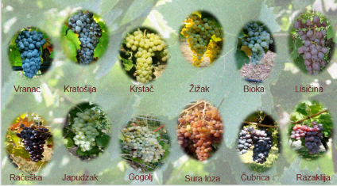
The one of results of work on characterisation of grapevine germplasm is the creation of National Collection of autochthonous grapevine varieties, on Ćemovsko field.
The Collection is planted with confirmed genotypes of autochthonous, neglected and indigenous grapevine varieties in Montenegro, in 2016 and it is continuously updated each year.

Slide 16
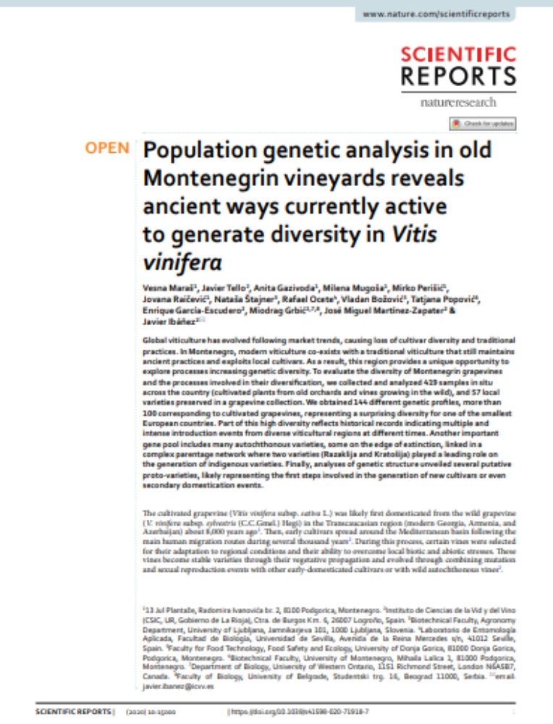
AEG-VIT-IS
The results of this research were recently published in the prestigious international scientific journal Scientific Reports (nature.com), with the open access. The paper presents the richness of the genetic heritage of the vine in Montenegro, which continues to create a very rich diversity within the species Vitis vinifera, enriching domestic and European viticulture and winemaking.
The paper is available on the journal's website: https://www.nature.com/articles/s41598-020-71918-7

Slide 17
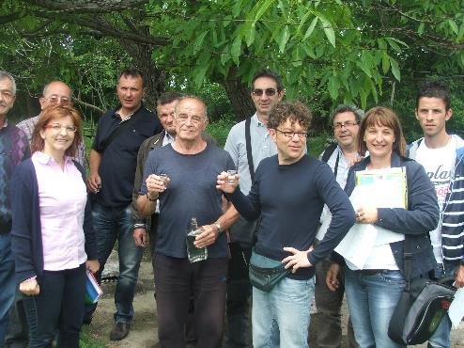
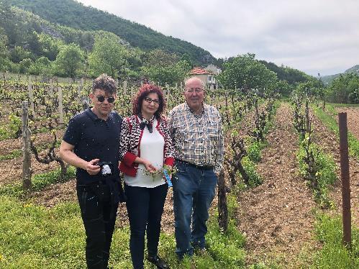
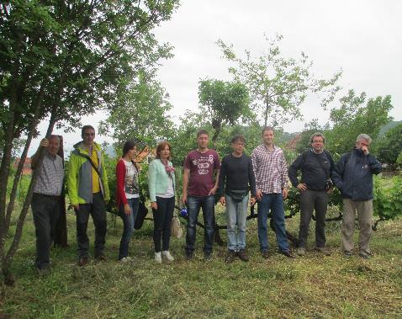
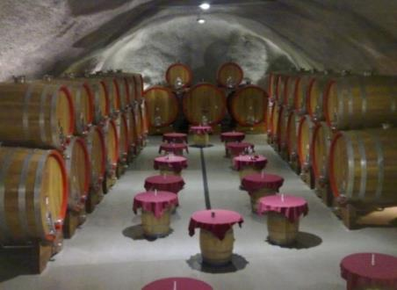
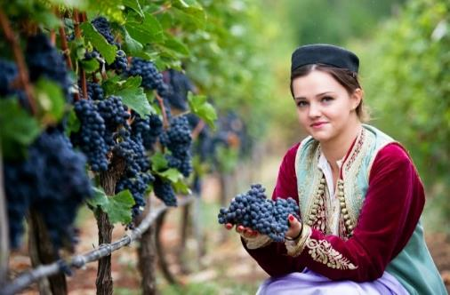
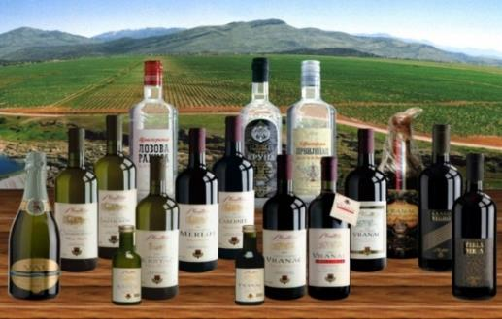
Thank you for the attention!
Notes:
17
17

