Slide 1
AEG-VIT-IS
Country: Latvia
Identification of a representative set of Vitis accensions of European origin well characterized to be included in AEGIS system
Latvian Vitis genetic resourses
Dzintra Dekena, Institute of Horticulture

Slide 2
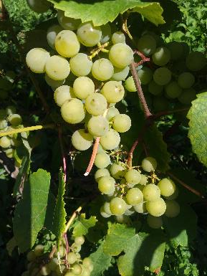
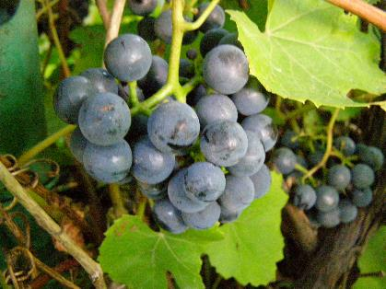
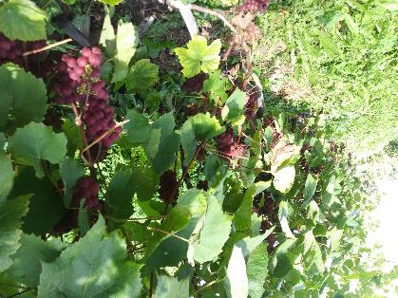
AEG-VIT-IS
Country: Latvia
Vitis genetic resouces in Latvia
 | Number of accsessions
Total collection | 91
GeNBIS | 15
VIVC | 12
European Vitis Database | 11
Zilga
Supaga
Guna

Slide 3
AEG-VIT-IS
Country: Latvia
List of Unique Vitis genotypes candidates for AEGIS and safety duplications
AEGIS candidate | Accession number, VIVC | Species | Genetic analyses | Protected in Latvia
Spulga | 23376 | Vitis interspecific crossing | X
Guna | 22882 | Vitis interspecific crossing | X
Zilga | 22255 | Vitis interspecific crossing | X
Supaga | 22881 | Vitis interspecific crossing
Sukribe | 22253 | Vitis interspecific crossing | X
Veina | 23253 | No information
Veldze | 22254 | Vitis interspecific crossing | X
Ciravas Agra | 23370 | Vitis interspecific crossing | X | X
Silva | 23229 | Vitis interspecific crossing | X | X
Liepajas Agra | 23373 | Vitis interspecific crossing | X | X
Liepajas Dzintars | 23227 | Vitis interspecific crossing | X | X
Dovga | 23563 | Vitis interspecific crossing | X | X

Slide 4
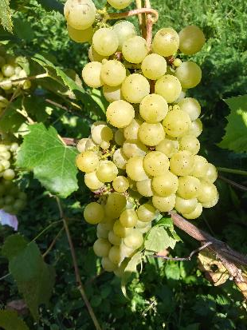
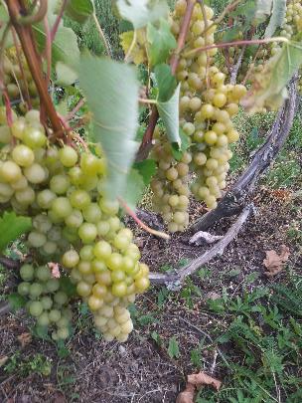
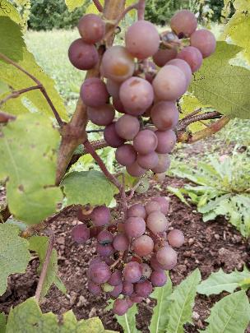
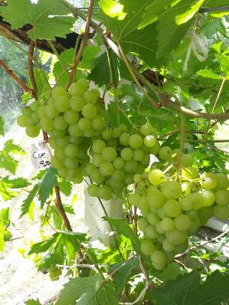
AEG-VIT-IS
Comments
Varieties Spulga, Guna, Zilga, Supaga, Sukribe, Veina, Veldze are old bred, created by Pauls Sukatnieks. As these varieties are crossings with including Vitis labrusca, they are winterhardy and distributed in the Northern regions: Estonia, Finland, and the North of USA.
Ciravas Agra, Silva, Liepajas Agra, Liepajas Dzintars and Dovga are new varieties created by breeder Gunvaldis Vesmins, where Vitis vinifera is one of the parents. They are also bred with an emphasis on winter hardiness, but the attention is also focused more on taste.
Cīravas Agra
Sukribe
Veldze
Spulga
Guna

Slide 5
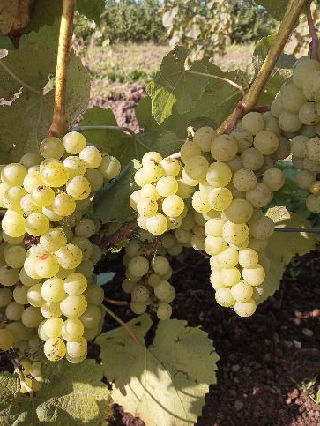
AEG-VIT-IS
Unsolved identities
AEG candidate | Genetic analyses
Meda
Lauma
Ritausma
Ciravas Balta | X
Ciravas Sarta | X
Comments
Lauma
Varieties Lauma, Meda and Ritausma are old varieties bred by Pauls Sukatnieks, created in Latvia, with very good winter –hardiness. These varieties are crossings with involving of Vitis labrusca and suitable for the Northern climate.
Ciravas Balta and Ciravas Sarta are new varieties bred by Gunvaldis Vesmins. These are crossings with the involving of Vitis vinifera. They are with improved taste properties.
All these varieties are not included in the Vitis International Variety Catalog.

Slide 6
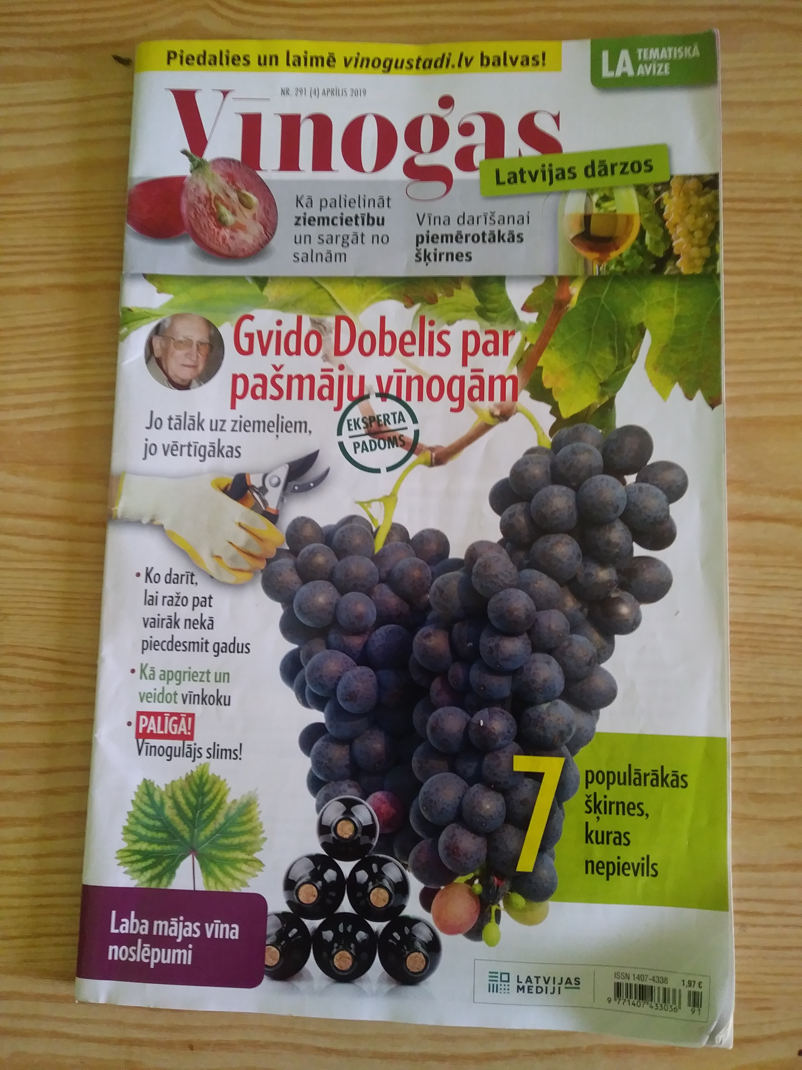
AEG-VIT-IS
References
G. Vēsmiņš, S. Ruisa and G. Lācis. (2016) Grape genetic resources and breeding in Latvia. Acta Hortic. No. 1139, p. 117 – 122.
Dēķena, Grāvīte (2019) Grape cultivars of Latvia origin in North countries. ’Līdzsvarota Lauksaimniecība’ zinātniski praktiskās konferences raksti, Jelgava, 79 – 84. lpp
Karvonen J. (2014). Vitis cv. Zilga is a vine for the northern temperate climate Hort. Sci. (Prague), Vol.41 p. 147–151.
Rätsep R. Karp K., Vool E (2014). Yield maturity parameters of hybrid grapevine (Vitis sp.) cultivar 'Zilga'. Research for Rural Development, Vol.1, p. 44 – 50.
Vool E., Rätsep R., Karp K., Bachman K., Moor U. (2014). The quality of grapes in open field and in protected cultivation conditions. In: Proceedings of the international conference “Horticulture in quality and culture of life”, Lednice, Czech Republic; 23.-26. September 2014. p. 839-846.

