Slide 1
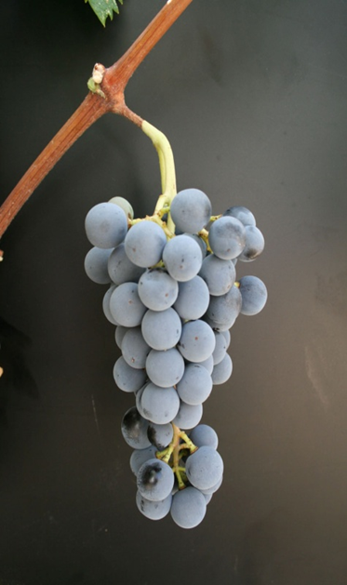
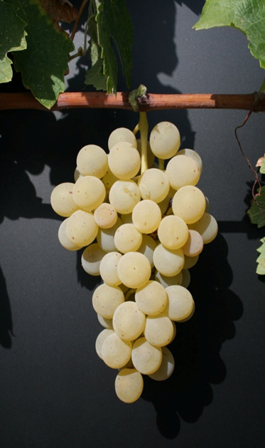
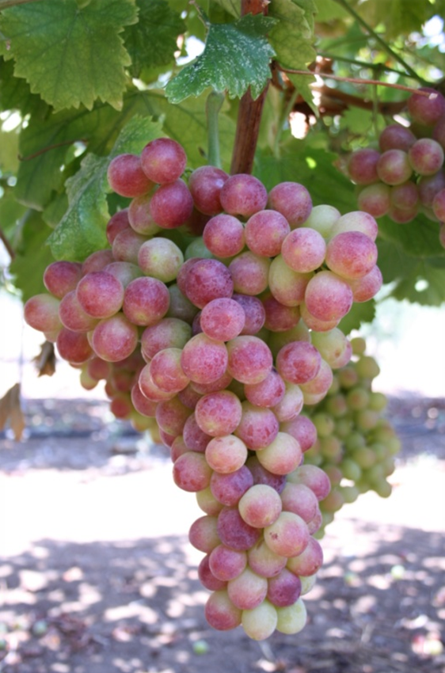
Country: Cyprus
AEG-VIT-IS
Unique genotype candidates for AEGIS : 11 varieties
Maratheftiko
Mauro
Opthalmo
Yiannoudhi
Xinisteri
Spourtiko
Promara
Vasilissa
Kanella
Veriko
Sideritis
Safety Duplications
Pre-basic collection (Agricultural Research Institute)
Basic collection (Department of Agriculture)
Autochthonous Wine grape varieties
Maratheftiko
Spourtiko
Autochthonous Table grape varieties
Veriko

Slide 2
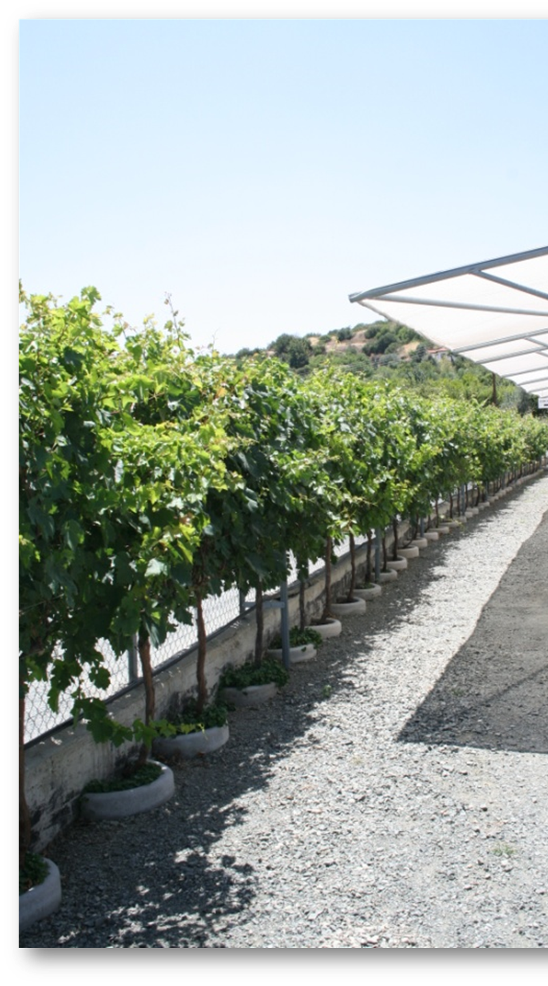
Country: Cyprus
AEG-VIT-IS
Unsolved identities (7 varieties)
Skouro mauro
Flouriko
Tsakrorogo
Mixalias
Yiallouriko
Glikopromo
Katomylitiko (autochthonous table grape variety)
Several wild varieties with agronomic and oenological value
Name of varieties not yet validated
Sanitary status of the material not known
Not characterized by ampelographic description and / or
molecular analysis
Wild vine collection
Autochthonous Wine grape varieties

