Slide 1
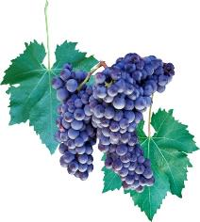
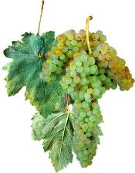
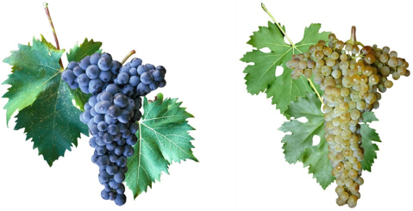
AEG-VIT-IS
Country: Croatia
Edi Maletić & Goran Zdunić
List of Unique genotypes candidates for AEGIS and safety duplications
(Outline the number of unique genotypes candidates for AEGIS in your country having into account the Guidelines.
Indicate the number of candidates with safety duplications in other(s) repositorie(s)
We have already nominated 90 cvs for AEGIS https://www.ecpgr.cgiar.org/aegis/european-collection/european-accessions/Croatia
We consider that cca 13O cvs are indigenous Croatian. They are collected in National Native Grapevine Varieties Collection (Uni Zagreb, Faculty of Agriculture);
All of them are identified (by ampelographic and SSR markers);
Almost all indigenous (or considered to be) Croatian cvs are safety duplicated in national safety collections (four). The new safety collection (Uni Osijek, Slavonia) is establishing;
Some new genotypes (newly found) are still unique in only one collection – need back up

Slide 2
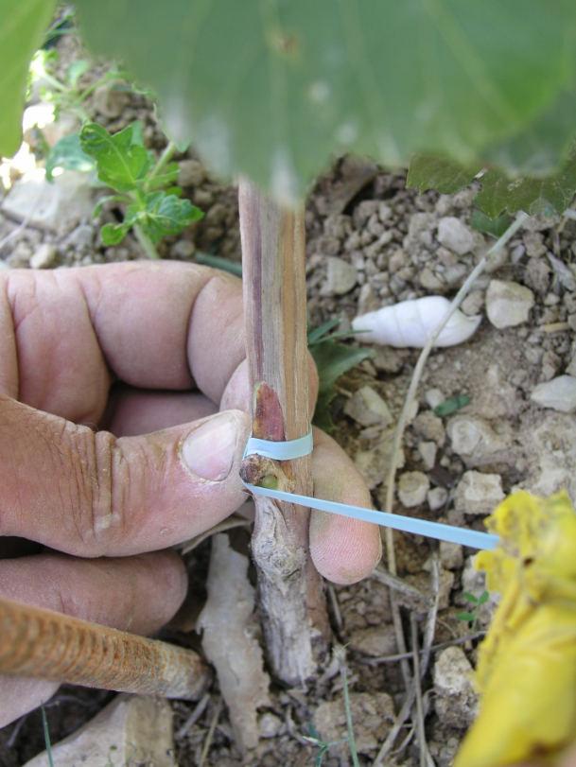
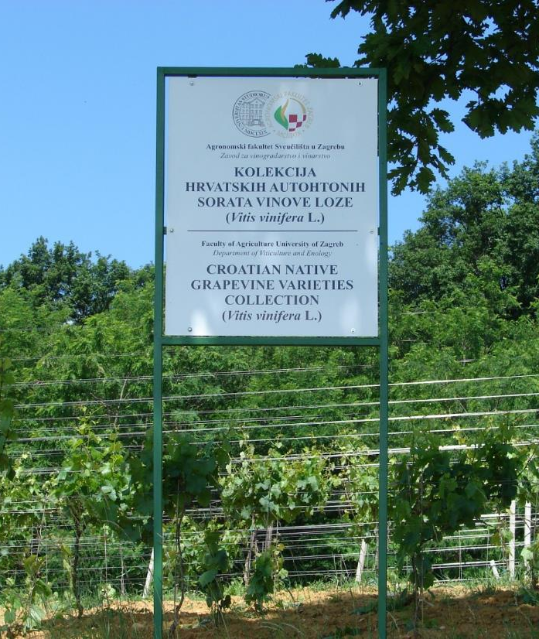
Establishing ex situ collection of Croatian native varieties from 2001: Faculty’s experimental field Jazbina (National collection: 140 accessions, 3-7 plants/variety)

Slide 3
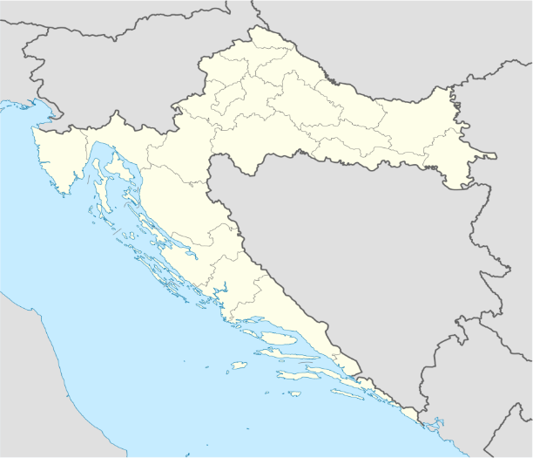


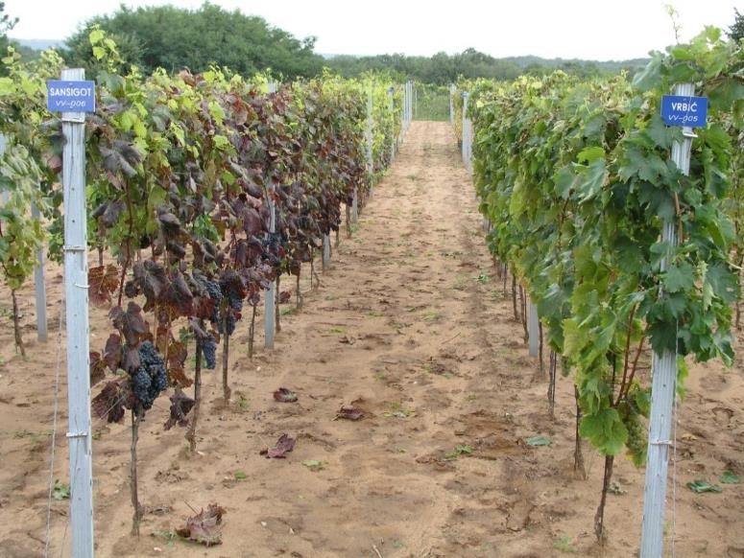
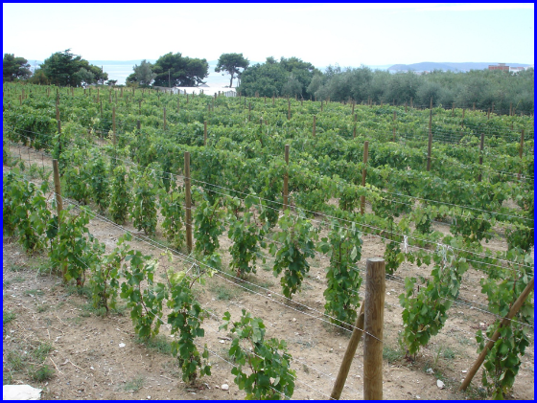
Regional collections:
ZAGORJE
ZAGREB
Split (Dalmatia), Poreč (Istria), island of Krk, Zagorje (NW Croatia), Osijek (Slavonia):
  Local native varieties
  Preservation (back-up collection), ampelographic and enological evaluation (10 – 50 plants/variety)
  Propagation (in some cases mother vineyard for rare varieties)
OSIJEK

Slide 4

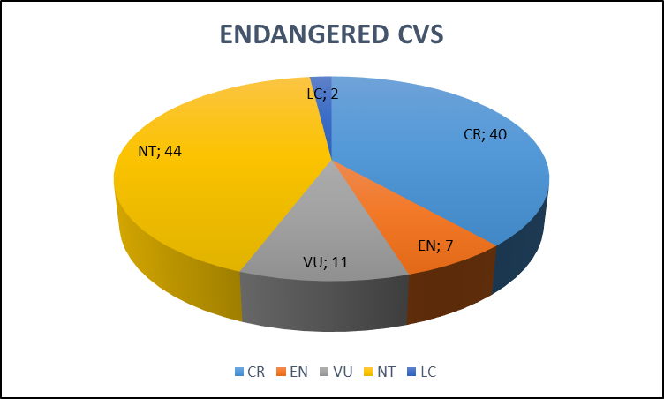
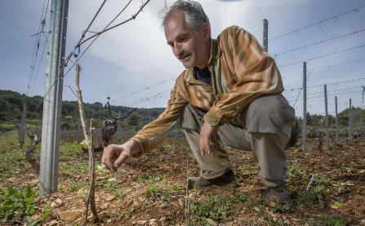
Status of vulnerability – extinction risk*
More than 50 % of cvs are endangered or vulnerable:
  CR (criticaly endangered): 40 cvs;
  EN (endangered): 7 cvs;
  VU (vulnerable): 11 cvs;
  NT (near threatened): 44 cvs;
  LC (least concern): 2 cvs.
  *folowing IUCN Red List Categories (International Union for the Conservation of Nature, 2001, Version 3.1. IUCN, Gland, Switzerland and Cambridge, UK.)

Slide 5
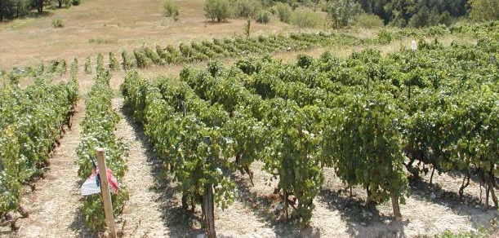
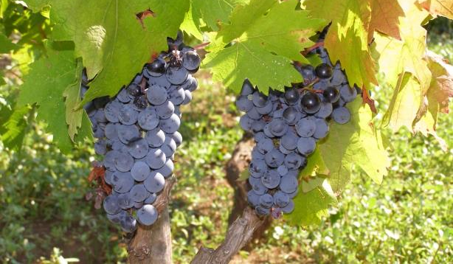
There are still old cultivars not present in genbanks
Possible to find individual genotypes in very old or abounded vineyards
Very often owner does not know the name of cultivar
Identification approach:
  Collecting information about cultivar from owner
  Consulting the old ampelography literature
  Labeling the individual vine in vineyard (GPS position)
  Primary morphology evaluation of vine in situ (collecting basic info about shoot, leaf, bunch)
  Collecting fresh young leaves for SSR analysis
  SSR analysis
  SSR profile comparison with other cultivars in Croatian database and VIVC database
  Propagation of unique genotypes in ex situ genbank

Slide 6
AEG-VIT-IS
Country: Croatia
Unsolved identities
(Outline the number of accessions not rightly identified in your repositorie(s)
genotype code | SSR match with… (VIVC or Cro database)
sta-kuc | Trbljan (Kuč)
sta gnjat1 | Dugovrst bijeli
sta kuc crv | Unique, unknovn
sta nnc | Unique, unknown
Korčula island | spont. crossing Plavac m x Kober 5BB
NN_POL01 | GB01=NNB-2 (Seeranet) unknovn
NN_POL02 | Pamidi
NN_POL04 | APSIMO PROSOTSANIS
NN_POL05 | Prokupac
NN_POL06 | Debit
PRI-BIL-L | Bilina privlačka
BRAJ_ORIG1 | Draganela
NN_KAS2 | Malvazija istarska
ZAG2017-1 | Unique, unknovn
ZAG2017-2 | Unique, unknovn
CUK01 | Unique, unknovn
CUK02 | Stara belina aromatična (Seeranet); V4.5; Slavitza (Romania), Lisztes feher (Hungary
CUK03 | Agostenga blanc
NN_MIR | Battraube
NN_PLAV_VIV | Plavec žuti
NN_GORB | Draganela
The example of identity check of some cvs found in old vineyards in Croatia (continental and coastal)
Some accessions are unique, with unknown identity. Forgotten varieties? In some cases we found single plants in nature with unique SSR profile – survived from former vineyard (>100 years) or seedlings?

Slide 7
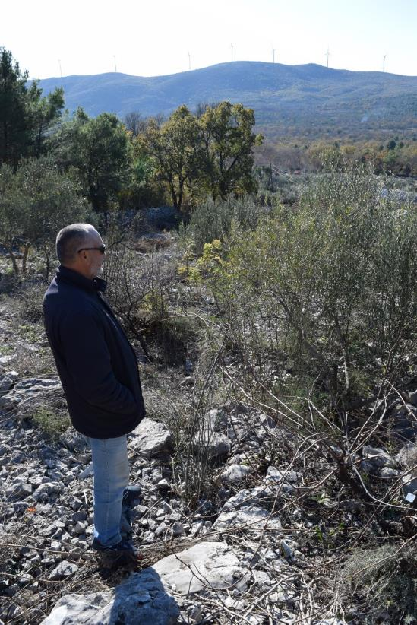
Example from Dalmatia hinterland - Resolved identity
19 unknown genotypes taken from numerous old vineyards in Dalmatia hinterland
Dugopolje location:
16 samples showed already known genotypes (Zlatarica vrgorska, Ninčuša, Maraština, Debit, Gegić and Glavinuša)
Unexpectedly:
  1 sample (IJK67) matched Citronelle blanc (from VIVC database); country of origin France
  2 samples matched Pamid (syn. Lisičina, Plodvina crvena) (from VIVC database); country of origin Bulgaria

Slide 8
Genotypes from Dalmatia: identity need to be resolved
On going task for 7 genotypes
SSR analysis preformed at 20 markers
SSR quality check and allele shift adjustment
Comparison with database
Genotype Code | Sample location | VVS2 | VVS2 | Zag62 | Zag62 | VVMD7 | VVMD7 | VVMD24 | VVMD24 | VVMD25 | VVMD25 | VVMD27 | VVMD27 | VVMD28 | VVMD28
IJK76 | Dugopolje | 135 | 153 | 196 | 196 | 247 | 253 | 206 | 206 | 249 | 255 | 180 | 195 | 244 | 244
IJK102 | Zemunik | 133 | 135 | 196 | 204 | 239 | 249 | 210 | 210 | 239 | 255 | 182 | 182
IJK198 | Bristivica | 133 | 144 | 188 | 190 | 239 | 249 | 204 | 210 | 240 | 240 | 190 | 195 | 244 | 248
IJK199 | Bristivica | 144 | 153 | 205 | 205 | 247 | 247 | 206 | 206 | 240 | 240 | 181 | 181 | 243 | 248
IJK200 | Bristivica | 133 | 144 | 188 | 200 | 239 | 249 | 210 | 210 | 239 | 239 | 190 | 190 | 257 | 257
IJK201 | Bristivica | 144 | 144 | 205 | 205 | 249 | 249 | 206 | 215 | 250 | 255 | 181 | 186 | 246 | 246
IJK202 | Bristivica | 144 | 146 | 194 | 205 | 249 | 249 | 206 | 206 | 242 | 255 | 186 | 186 | 246 | 268

Slide 9
AEG-VIT-IS
Country: Croatia
Comments
Sharing the knowledge (protocols, characterization data etc.) and plant materials within AEGIS would facilitate conservation of PGR;
Criteria (technical standards) for inclusion of some cultivar in AEGIS need to be discussed;
Access to characterization and evaluation data for cultivars has to be publically open for scientific and breeding purposes;
How to secure safety duplication for clonal variants (e.g. several different accessions of single cultivar – intravarietal variability)? Has to be subject of discussion, too.
(Any free comments and suggestions about the work done and work in progress)

